Slide 1
Gas Turbine Air Treatment Route Map and Summary
This sequence of power points will be displayed at 3 PM on April 28 and will be the background for the discussion
AFS Program Overview
Decision Guide, Decision Orchard, AFS, and International Filter News
Hot Gas Filtration Decision Guide

Slide 2
Program Overview
General
Specific: GT Inlet Air Filters
The 90 minute session will be focused on a slide by slide display of the summary power points.
As each slide is displayed there is the opportunity for discussion. It would start with the slide author if he so wishes.
Designated panelists as well as the entire group will be encouraged to ask questions and make observations.
Panelists and participants are encouraged to submit power points to be included in the summary.
Anyone is encouraged to submit articles and presentations for inclusion in the Gas Turbine Combined Cycle Decisions Orchard.
The Filtration News article in June will be based on the conclusions reached in the session.
The summary and the intelligence system will be continually updated.
Provide access to GT Inlet Air Filter Decision Guide upon registration
Provide updated version of GT Inlet Air Filter Decision Guide prior to the event
Provide contact among presenters and attendees before, during and after the event
Conduct the program as a series of panels
Continue upgrading of GT Inlet Air Filter Decision Guide
Post presentations into the Decision Orchard
Publish articles in International Filtration News

Slide 3
GT Inlet Air Filter Decision Guide is part of a whole system
 |  |  | IFN article
 | Gas Turbine and Combined Cycle Decisions Program with GTCC Decision Orchard, decision guides, and operating system
 | 4As Operating system Alerts: Weekly GTCC Alert and articles in CCJ and IFN Answers: Orchard Answers with Decision guide locator Analysis: conference debates, hot topic hours , expert support , white papers and InterWebviews™ in many languages Advancement: recorded webinars and access to program
--------------------------------------- Global Decisions Orchard ---------------------------------------
This GdPS is part of a whole system. It is route map to the larger database and a complete service for gas turbine operators – Gas Turbine and Combined Cycle Decisions.
The June Filtration news article will be a compressed version of the revised summary as shaped by the AFS session.

Slide 4
Panelists
Company | Name
Ahlstrom | Ina Parker
Clarcor | Steve Hiner
Donaldson | Eli Ross
Freudenberg | Mike Garnett
Hollingsworth & Vose | Andre Boni Mike Malloy
Lydall | Geoff Crosby
W.L. Gore | Tom Kelmartin

Slide 5
Gas Turbine Inlet Air Filtration Decision Guide
A route map and summary of options available and the merits of each based on purchaser’s unique circumstances
Modified for AFS April 28 Discussion
4/20/15 DRAFT

Slide 7
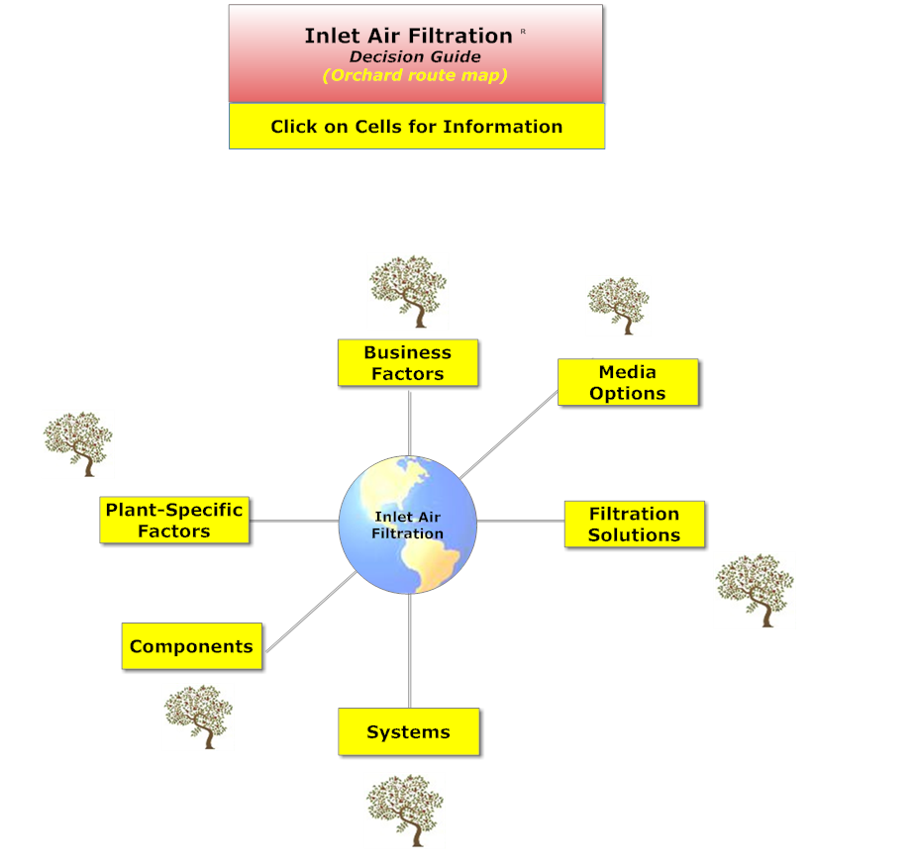
Business Factors
Regulatory
U.S
EU
China
Other
Economic
Macro
Micro
  Plant life
  Parasitic power cost

Slide 8
I. Regulatory, Economic and Site Specific Impacts on Filter Choice
Subject | Slide Contributor | Relevant decision
Regulatory Impacts | McIlvaine | Gas and renewable generation will grow as coal and nuclear plants are retired
Priority Ranking | Barilla | What factors must clearly be considered vs. more “grey” factors?
Overview of Environmental Conditions | GE | What challenges are presented by various regional environments?
Coastal, Marine and Offshore Conditions | McIlvaine | What considerations are involved in designing air inlet filtration systems for coastal environments?
Desert Conditions | McIlvaine | Same – for desert environments.
Arctic Conditions | McIlvaine | Same – for arctic environments.
Tropical Conditions | McIlvaine | Same – for tropical environments.

Slide 9
Regulatory Impacts:
Gas turbine capacity will grow as regulations shift the energy mix away from coal and nuclear generation
Coal plants are being retired worldwide due to environmental concerns and regulations
Mercury, particulates, SO2, NOx
Greenhouse gas regulations such as New Source Performance Standards (NSPS) for new plants and Clean Power Plant Program for existing plants in the U.S.
Nuclear plants are being retired in Japan, Germany and elsewhere as a consequence of the Fukushima disaster
Gas-fired power generation will increase to fill the gap
In addition, greenhouse gas regulations are promoting renewable energy, which will require quick-start gas-fired units for backup

Slide 10
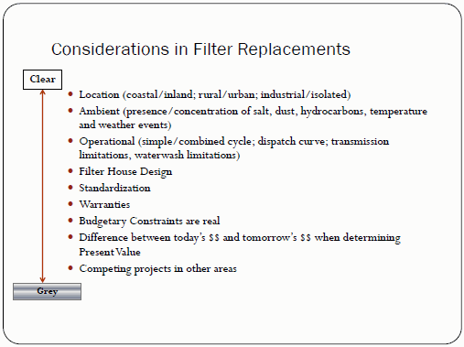
Priority ranking of filter selection factors (Barilla)
Gas Turbine Inlet Filters - Value Considerations in Filter Selection by Paul Barilla - Hot Topic Hour May 15, 2014

Slide 11
Plant specific factors
Environment
Coastal
Marine
Offshore
Desert
Arctic
tropical
Combustion
turbine design
Fuel additives
Fuel
Heat recovery

Slide 12
Conditions encountered depending on location (GE)

Slide 13
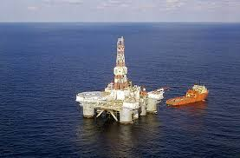
Coastal, Marine and Offshore Conditions
Guideline for Gas Turbine Inlet Air Filtration Systems
Understanding the Benefits and Limitations of EPA Filtration--Filtration News, April 2015
Filtration Efficiency’s Impact on Compressor Health--Filtration News, April 2015
The main difference between coastal and land based applications is the concentration of salt in the atmosphere. Salt is a main contributor to corrosion and can lead to fouling of compressor blades.
Coastal environments refer to gas turbines installed on land but within 10 miles of a salt-water shoreline. At 8 to 12 miles from the shoreline, salt concentrations in the air drop to natural background levels.
Marine environments refer to gas turbines installed on vessels, where the inlet is generally within 100 feet from the ocean’s surface.
Offshore applications are typically oil production platforms with gas turbine inlets more that 100 feet from the ocean’s surface.
Air intake filtration systems must be designed to handle
  moisture and salt and are typically include:
  Weather protection (such as a weather hood)
  Vane separators or coalescers to address moisture
  Pre-filters and/or high efficiency filters to address salt

Slide 14

Desert Conditions
Dust and sand are the main contaminants in desert environments. Initial separators can remove the larger dust particles, followed by pre-filters and high efficiency filters to remove the smaller particles.
  However, modern self-cleaning cartridge filters with pulse cleaning have largely replaced separator/pre-filter/high efficiency filter arrangements, which tend to be more expensive due to the cost of frequent filter change outs.
Some desert locations experience periods of dense fog and high humidity, particularly in coastal regions in the Middle East. The moisture can collect on the surface of cartridge and self-cleaning filters, causing the dirt to form a cake which reduces the effectiveness of the filter and pulse-cleaning
mechanism.
Air intake filtration systems in desert environments
  typically include:
  Weather protection (such as a weather hood)
  Vane separators or coalescers, where appropriate,
    to address moisture
  Self-cleaning cartridge filters to address dust and sand

Slide 15
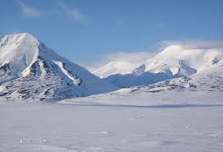
Arctic Conditions
Guideline for Gas Turbine Inlet Air Filtration Systems
Arctic environments are characterized by lengthy periods of time with temperatures below 32° F (0° C). The main concern for air intake systems is the removal of snow and prevention of ice formation and buildup.
Inlet filter housings should be elevated to minimize the ingestion of snow and ice, with consideration given to the expected height of snow in winter months.
Weather hoods should have a large entrance areas which decreases velocity and the likelihood that show will be pulled into the filtration system.
Ice can be formed if the temperature of humid air in the inlet system decreases, causing water particles to freeze. Moisture in the air can be due to:
  Cooling tower drift. The plant should be laid out to minimize the potential cooling tower aerosols to enter the intake system.
  Ice fog, which typically starts to form at temperatures below -15° F,
Anti-icing systems mix heated air (from compressor bleed or gas turbine exhaust) with cold inlet air. Alternatively, pulse cleaning systems have
  been found to be effective in preventing ice build up.
Air intake filtration systems in artic environments include:
  Elevated intake structures
  Weather protection (such as a weather hood or louvers)
  An anti-icing system with pre-filters OR self-cleaning filters
  High efficiency filters

Slide 16
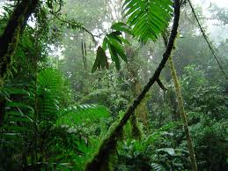
Tropical Conditions
Guideline for Gas Turbine Inlet Air Filtration Systems
Tropical environments are characterized by high temperatures, high humidity, monsoons, high winds and insect swarms. Due to extensive vegetation, it is considered a low dust environment.
The primary contaminants are water and insects, and salt for locations near the shoreline.
Filtration systems in the topics are specifically built to handle large amounts of rain. Weather hoods are used as a primary defense, typically followed by a vane axial separator and coalescers to reduce water intake.
Large area insect screens with low inlet velocities are used to block ingestion of insects.
High temperatures and high humidity lead to the formation of mold fungus and corrosion. Therefore, all metal inlet parts should be made of corrosive resistant materials or coated with corrosion protection.
Air intake filtration systems in tropical environments include:
  Weather protection (such as a weather hood)
  Insect screens
  Vane axial separator, coalesce
  Pre-filter and high efficiency filter
  Corrosion resistant metal parts

Slide 17
Decision Route – Regulatory, Economic and Site Specific Issues
Webinars (Protected)
Intelligence System Key Words
Date | Recording Title
February 5, 2015 | Gas Turbine Regulatory Drivers 120 minutes
May 15, 2014 | Gas Intake Filters: HEPA or Medium Efficiency 101 minutes
InterWebViewsTM (Free)
Date | Topic
Search Category | Key Words
By Product | Air Filter Air Inlet House
By Company | General Electric, Nederman
By Person | Barilla
By Regulation | Greenhouse Gas
By Topic | Humidity Moisture

Slide 18
Media options
Non woven
Woven glass
Membranes
Ceramic
metallic

Slide 19
II. Fiber and Media Choices
Subject | Slide Contributor | Relevant decision
Overview of Media Options | McIlvaine | What factors should be considered in selecting the filter media?
Efficiency Levels | Mcilvaine | What are EPA, HEPA and ULPA filters?
Efficiency Levels | Gore | What are the differences between high and very high efficiency filters? (2 slides)
Air Filter Standards | Freudenberg | What are the EN779, Ashrae and ISO standards applicable to air intake filters? (2 slides)
Media Selection | Hollingsworth & Vose | What factors should be considered in selecting the filter media? (6 slides)
Combo vs Synthetic or Glass | Midwesco | How does the performance of a synthetic/glass combo filter compare to other media?
Expanded Metal & Plastic | Dexmet | How can expanded metal and plastic media be used in gas turbine applications?
Nanofibers | Lydall | What are the benefits of nanofibers?

Slide 20
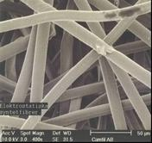
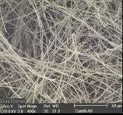
Overview of Filter Media Options
Two primary types of media are available:
Synthetic, typically with coarser fibers
  3.0 to 4.0 µm diameter
Glass, typically extruded to a smaller fiber diameter
  1.0 to 1.3 µm diameter
  Higher dust holding capacity
  Stiffer fibers, able to resist higher pressure drops and last longer
Fiber selection criteria:
Efficiency rating
Fiber size, diameter
If synthetic, which resins
Synthetic Media
Glass Media

Slide 21
Three Levels of High Efficiency
The three common types of high efficiency filters are EPA, HEPA, and ULPA, defined as follows:
EPA filters have a minimum efficiency of 85% for removal of 0.3 µm diameter or larger particles
HEPA (High Efficiency Particulate Air) filters have a minimum efficiency of 99.97% for removal of 0.3 µm diameter or larger particles
ULPA (Ultra Low Penetration Air) filters have a minimum efficiency of 99.9995% for removal of 0.12µm diameter or larger particles

Slide 22
Differences Between High and Very High Efficiency Filters (Gore)

Slide 23
Make Sure to Use Relevant HEPA Rating (Gore)

Slide 24
Air Filtration Standards ( Freudenberg)
.
EN779: 2012 supersedes 2002.
Europe use EN779 (Fine filters) & EN1822 (EPA)
North America: Ashrae 52:2 (MERV) & DOP
Rest of the World is a mixture of both standards.
Japan: JIC
New ISO test protocol dedicated to rotating equipment is a worldwide standard. (Different to old EN779 which was based on HVAC filter testing).
Dr. H. Manstein - 06.05.2015

Slide 25
Air Filtration Standards (Freudenberg)
ISO / FDIS 29461 -1:2011 (E) ISO/TC 142/SC WG9
Air intake filter systems for rotary machinery
.
Part 1: Test method and classification for static filter elements. (Introduction of a discharge test ,minimum 04.um percentages & higher final differential pressure limits).
Part 2: Test method and classification for cleanable (Pulse Jet) filter systems
(draft being reviewed)
Part 3: Integrity testing (environmental conditions, mechanical strength).
Part 4: In-Situ testing – real operating performance.
Part 5: Marine and Off-shore - (draft being compiled)
Part 6: Cartridge testing method for individual cartridges. (draft being compiled)
Dr. H. Manstein - 06.05.2015

Slide 26
Media Selection = f(Filter System, Element type)
(Hollingsworth & Vose)
GT Filter System
Static
Pulse
Pre-Filter
Fine Filter
Final Filter
Pleated Panel
Pocket filter
V-type filter
Pocket filter
Glass mat
Synthetic
Glass paper
Synthetic
Composite
V-type filter
Glass paper
Composite
Cylindrical / Conical element
Cellulose
Glass paper
Composite
Cylindrical / Conical element
Composite
Cellulose
Cellulose glass/ synthetic
Factors Influencing Selection
Turbine Location
Test Standard
Turbine Regime and Type

Slide 27
  Test Standard to be Considered
  (Hollingsworth & Vose)
  Mechanical vs Charged Media
    There are major differences in the test – and classification systems of standards and their revision
      ASHRAE 52.2 : 2007 or 2015, Appendix J
        Discharging is not mandatory and has no effect on classification
      EN779 : 2002 or 2012
        2002: discharged value is reported but has no effect on classification
        2012: discharging is mandatory for F7 – F9 and influences classification

Slide 28
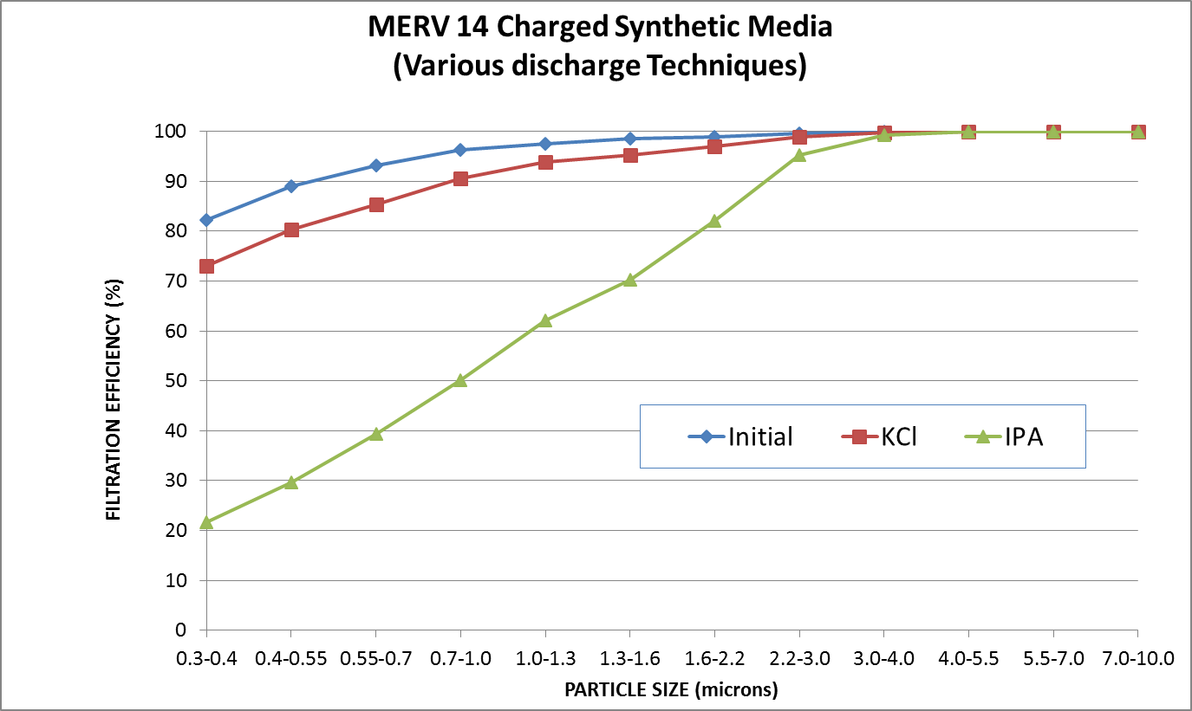
HVAC – Discharge Impact of Charged Media
(Hollingsworth & Vose)
Initial Frac Eff.
ASHRAE 52.2 App J
EN779:2012

Slide 29
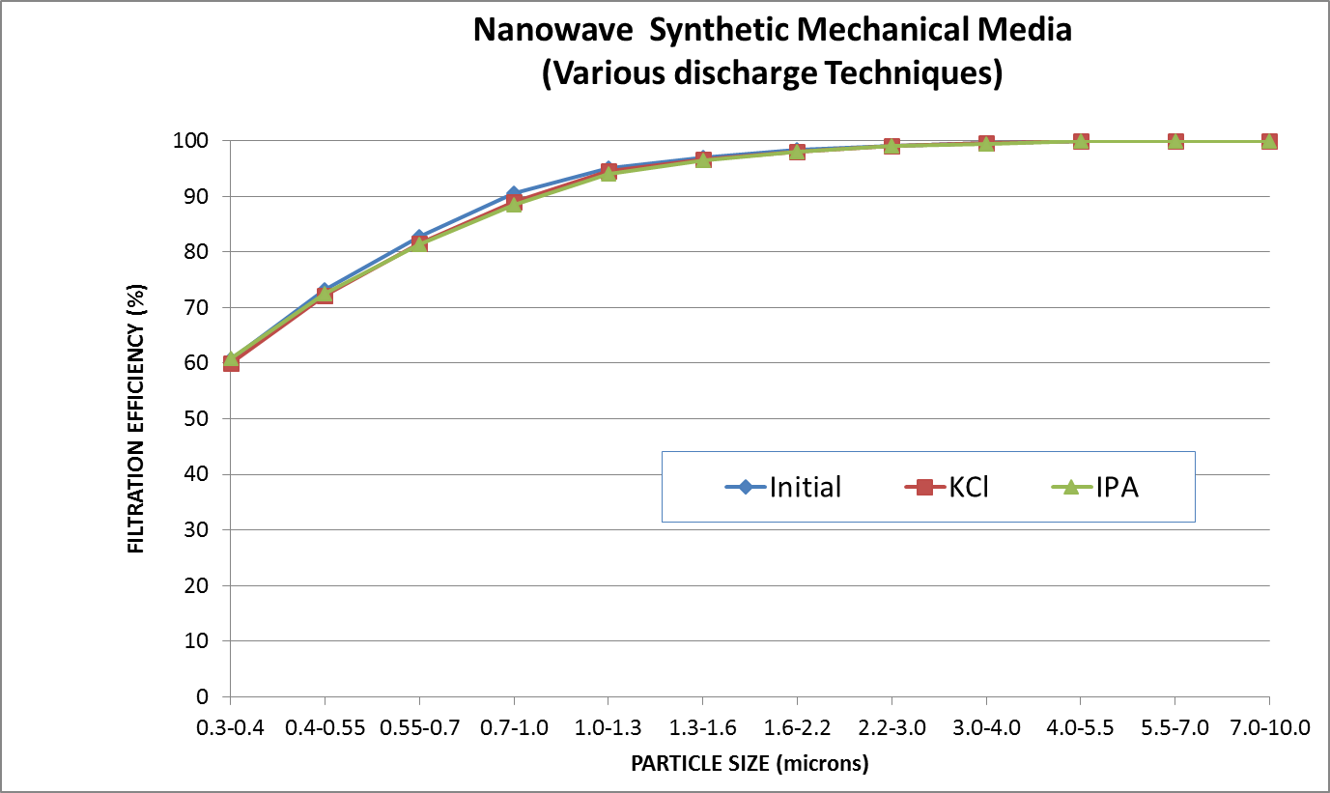
Discharge Characteristic of Mechanical Media
Wet laid glass and NanoWave®
(Hollingsworth & Vose)

Slide 30
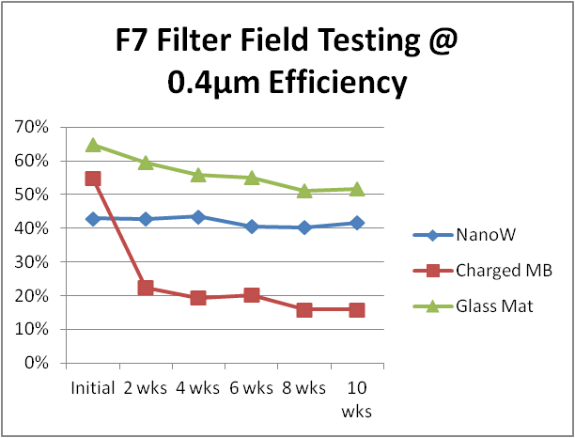
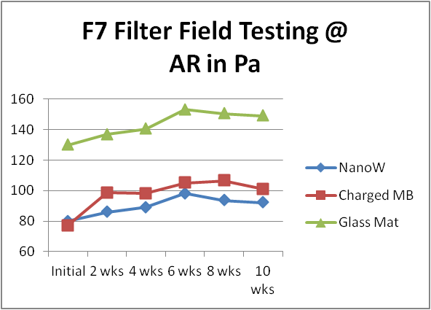
Evolution of Filter Performance
(Hollingsworth & Vose)
Rapid Loss of 0.4µm Efficiency
Increased Air Resistance in 2 weeks
MERV12 Filter Field Testing
0.4µm Efficiency
MERV12 Filter Field Testing
Air Resistance in Pa
IPA Discharged Efficiency
Charged media can rapidly lose all performance
IPA discharge simulates real life
Charged synthetic media quickly increases air resistance
High air resistance and energy usage
24

Slide 31
H&V Media Selection for GT
(Hollingsworth & Vose)
Cellulose
Cellulose Synthetic / Glass
Cellulose composite
Glass media
Glass Composite Media
Synthetic
NanoWave®
Pocket Media
Pleated media
H&V

Slide 32
Polymer Group Gas Turbine Media
Everist™ high efficiency filtration media
outperforms traditional mechanical and synthetic composite media
meets all demands put forward by gas turbine manufacturers
  Nanofiber-based technology
  Enhanced Efficiency
    Everist media provides a higher initial efficiency and the same mechanical efficiency as glass, while providing the same initial efficiency and a higher discharge efficiency vs. synthetics
  Low Pressure Drops
    The nanofiber-based technology in Everist media provides half the pressure drop of glass media and is similar to electrostatically-charged synthetics.
  Excellent Dirt Holding Capacity
    PGI's Everist media doubles the dirt holding capacity of synthetic composites and has a similar capacity to glass
  Best-in-Class Processing
    Everist media pleats on both rotary and blade pleaters and can be sonically welded
  High Durability and Sustainability
    This new technology is both more durable than glass and greener than traditional media

Slide 33
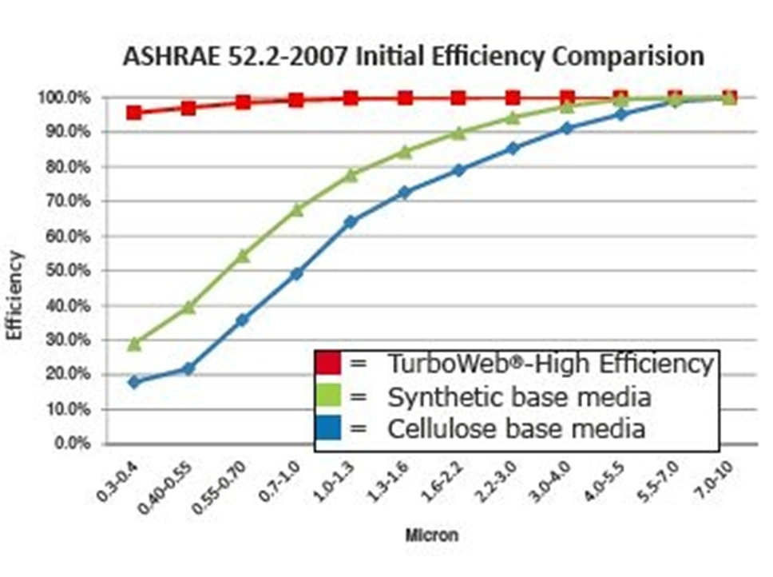
TurboWebTM Filter Compared to Other Media (Midwesco)
TurboWebTM is a 3 layer ultra-high efficiency media.
Layer 1: Proprietary high efficiency laminate
Layer 2: Special treatment to resist moisture and salt from entering the media
Layer 3: 100% synthetic

Slide 34
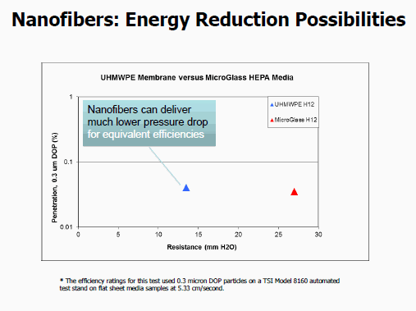
Nanofibers (Lydall)

Slide 35
Lydall Gas Turbine Filter Media Simplified Decision Matrix
Solution | Technology | Filtration Efficiency |  |  |  | Cleaning Mode |  | Filtration Mechanism |  | Water Resistance | Oil Management
 |  | MERV 11-15 F6-F8 | MERV 16 F9 | E10 | E12 | Pulse | Static | Mech. | Charged
Arioso Composites | Membrane Composites |  | + | + | + | + | + | + |  | +++ | +++
LydAir MG ASHRAE | MicroGlass | + | + |  |  |  | + | + |  | + | +
LydAir MG HEPA | MicroGlass |  |  | + | + |  | + | + |  | ++ | ++
LydAir SC | Synthetic Composite | + | + |  |  | + | + |  | + | + | ++
LydAir MB | Meltblown | + | + |  |  |  | + |  | + | + | ++
Note: Lydall Lamination Techologies and multiple Functional Support Layers are available for use with all product families.

Slide 36
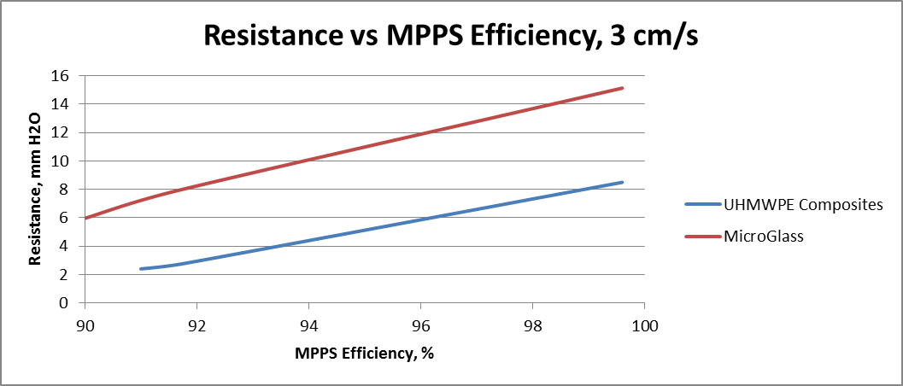
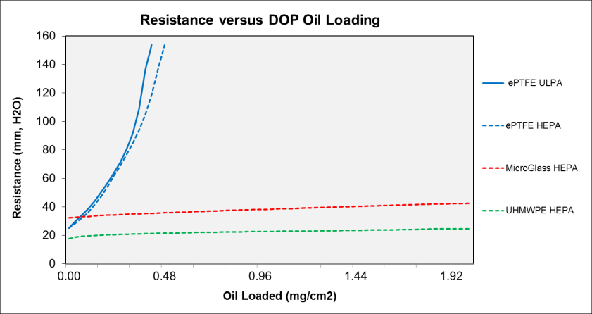
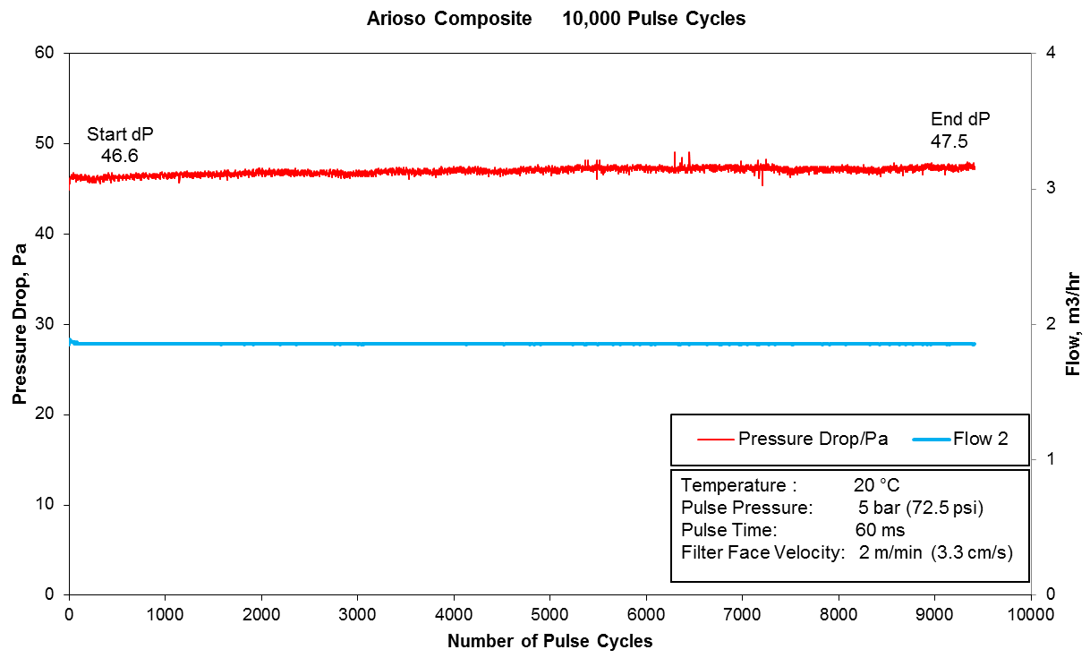
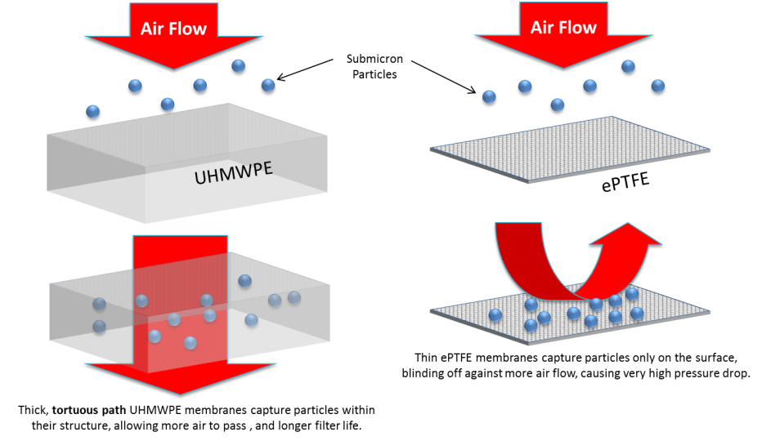
Gas Turbine Air Inlet Filtration: Membrane Composite Considerations
Mechanical Filtration Efficiency
Tests at design velocity to prove E10 to E12 performance
Oil & Hydrocarbon Management
Oil loading to simulate oily/hydrocarbon environments
E11
E12
Designs for Pulse or Static Operation
Pulse testing to validate durability and dust release
Filter Life
Depth loading membranes, versus surface loading

Slide 37
Decision Route – Fibers and Media
Webinars (Protected)
Intelligence System Key Words
Date | Recording Title
February 5, 2015 | Gas Turbine Regulatory Drivers 120 minutes
May 15, 2014 | Gas Intake Filters: HEPA or Medium Efficiency 101 minutes
InterWebViewsTM (Free)
Date | Topic
Search Category | Key Words
By Product | Air Filter Air Intake House
By Company | Dexmet, Hollingsworth & Vose, Lydall, Midwesco
By Topic | Efficiency

Slide 38
Filter Choices

Slide 39
III. Filter Choices #1 - Performance
Subject | Slide Contributor | Relevant decision
Performance Criteria
Pressure Losses | Southwest | What filter designs provide acceptable pressure losses?
Problems with Particulates | Mcilvaine | How can air inlet systems be designed to address corrosion, erosion or fouling issues?
Problems with Particulates | Clarcor | How can air inlet systems address fouling? (4 slides)
Problems with Moisture | Nederman | How should a filter house be designed to address moisture issues?
Problems with Moisture | Freudenberg | How can air inlet systems be designed to address moisture issues? (3 slides)
Options for Snow and Ice | GE | What options are most effective in dealing with snow and ice?

Slide 40
High Efficiency Filter Pressure Losses (Southwest)
In order to achieve the high filtration efficiency, the flow through the filter fiber is highly restricted which creates a high pressure loss, unless the face velocity is kept low.
The initial pressure loss on high efficiency filters can be up to 1-in. H₂O (250 Pa) with a final pressure loss in the range of 2.5-in. H₂O (625 Pa) for rectangular filters and 4-in. H₂O (2000 Pa) for cartridge filters.
High efficiency filters used with gas turbines have pleated media that increase the surface area and reduce the pressure loss.

Slide 41
Filter Performance: Problems with Particulates
Corrosion
Loss of material caused by a chemical reaction between machine components and contaminants, which can enter the gas turbine through the gas stream, fuel system or water/steam injection system.
Salts, mineral acids, elements such as sodium, vanadium, and gas, including chlorine and sulphur oxides in combination with water, can cause corrosion.
Erosion
Erosion is the abrasive removal of material by hard particles suspended in the gas stream.
Particles causing erosion are normally 10 microns or larger in diameter. Particles with diameters between 5 and 10 microns fall in a transition zone between fouling and erosion.
Erosion damage increases with increasing particle diameter and density, flow turning and gas velocity, and with decreasing blade size.
Turbine and compressor manufacturers minimize erosion by increasing trailing edge thickness, installing field replaceable shields and using improved alloys.
Nevertheless, they all recommend fine inlet filtration to prevent hard particles from entering the turbines.
Fouling
Fouling is the adherence of particles and droplets to the surface of the turbomachine blading. This degrades flow capacity and reduces efficiency in a short period of time.
Fouling can normally be reversed by cleaning, but it often requires downtime. Fouling is a serious problem, particularly in the oil and gas industry where sticky hydrocarbon aerosols are universally present.
Traditionally, no accommodation has been made in designing turbines to tolerate deposition tendencies of particulate-laden gas streams. Although the deposition trajectories can be predicted for some turbine blades, the actual fouling is very much dependent on inlet gas cleanliness which varies unless it is controlled.

Slide 42
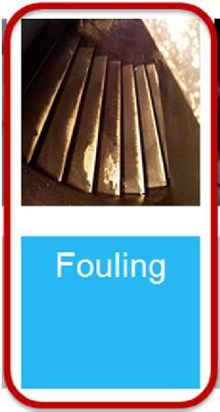
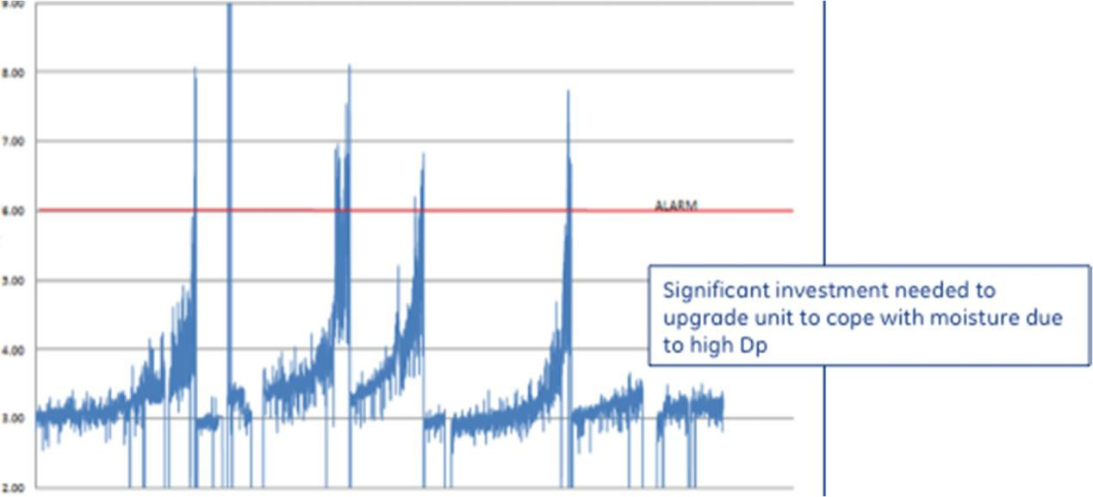
Two ways to stop fouling –
Stop fine (<1 micron) particulate reaching the GT
  Use of high efficiency filters, typically E10 or above
  EPA / HEPA alone only addresses dry contaminants
  Filter likely to be more sensitive to moisture
EPA / HEPA filters can exhibit very unpredictable characteristics:
    Reaction to humidity/fog
    Fast pressure drop build
    Leads to unexpected outages
PRESSURE LOSS (INWG)
TIME

Slide 43
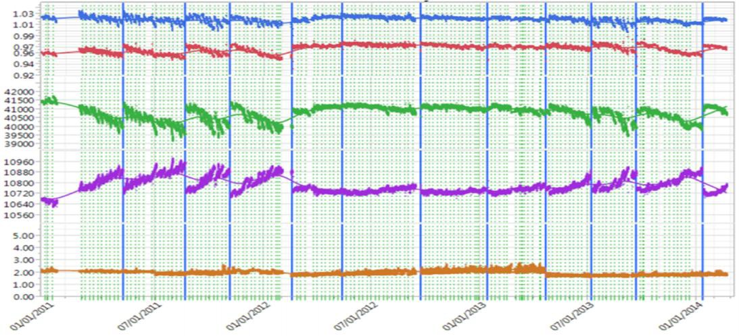
Two ways to stop fouling –
2. Stop contaminants from sticking to the compressor blades
– Sticky contaminants such as, salts and hydrocarbons etc. are much more likely to cause fouling by making the blades sticky which then enable them to foul with dry inert particulate.
Use of hydrophobic and advanced fibre coated filters can significantly reduce sticky contaminants getting to the GT
–
EXAMPLE
DMM_Comp_ Flow DMM_Comp_ Eff
Output (kW)
Flat compressor degradation from coated filter
Heat Rate (BTU/kWhr)
Inlet DP (inH2O)
TIME
Traditional F9 Synthetic with nano
Coated F9 synthetic installed
Traditional F9 Synthetic with nano

Slide 44
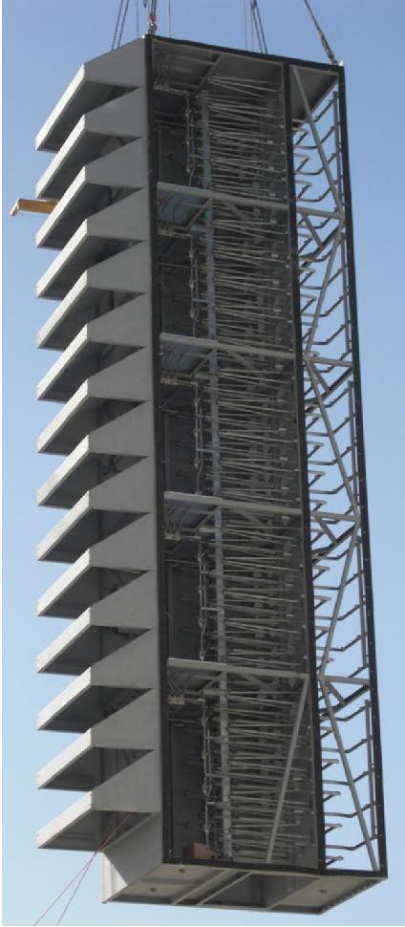
Industry trend (Clarcor)
The industry trend is for increased GT availability in all environments while using ever newer, more complex and sensitive gas turbines.
This results in a need for:-
Higher efficiency filters – Fine fibre (Nano)
Filters with longer life – Multi layer composites that are highly pleatable
Filters with predictable performance and no surprises – Advanced coatings with moisture management addressed that have been extensively tested in the real world
Robustly designed filters – Strong filter media

Slide 45
Challenges for the Nonwovens Industry
Higher efficiency (EPA / HEPA) media that is less sensitive to mist, fog or hydrocarbons especially when loaded in the real world
As 1 above specifically for surface loading media for pulse cleanable products
Proven through life (real world) hydrophobic properties
Synthetic media that truly holds or improves it’s efficiency through real world loading
Longer life media
Higher strength media that can be pulsed
Focus on pleating, self supporting, corrugation etc.
Advanced fibre coatings
Essentially there is a growing need for cost effective, composite media using multiple non-woven and coating technologies in a single media available from multiple global locations

Slide 46
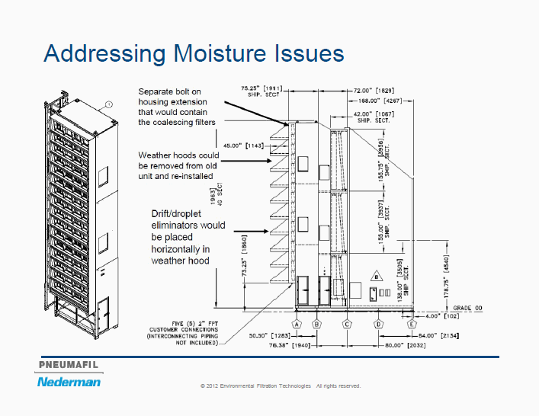
Filter house design to reduce moisture (Nederman)

Slide 47
Freudenberg Filtration Technologies.
Air filtration.
M. Garnett
28th April 2015
Freudenberg Filtration Technologies.

Slide 48
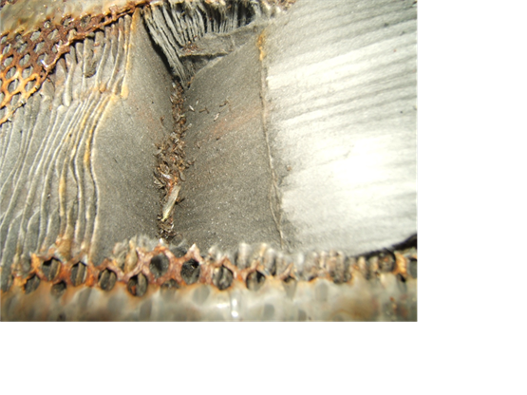
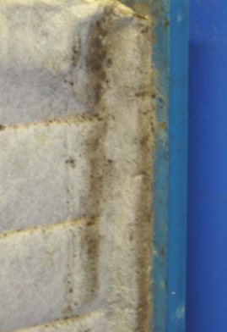
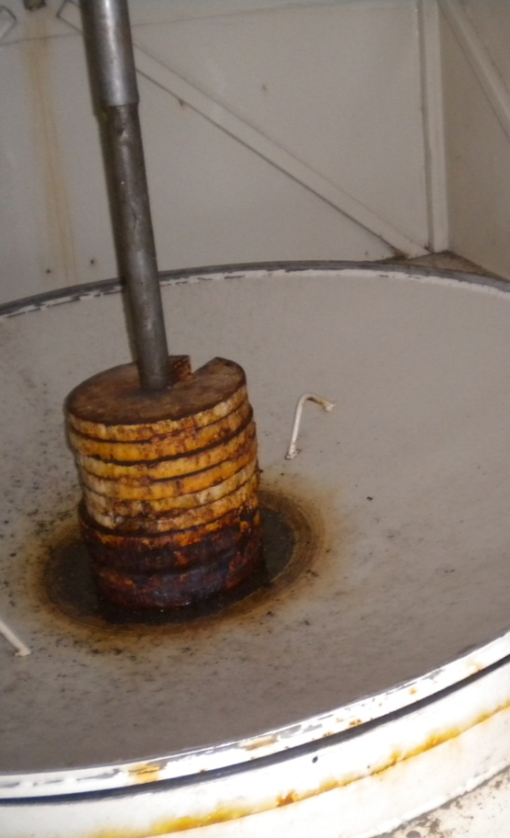
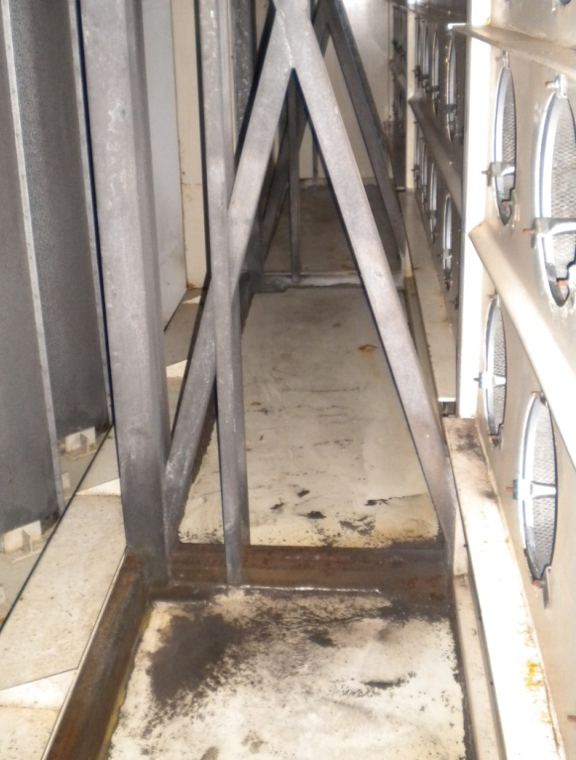
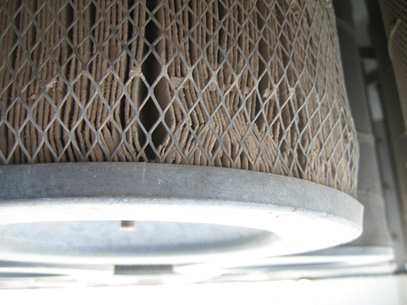
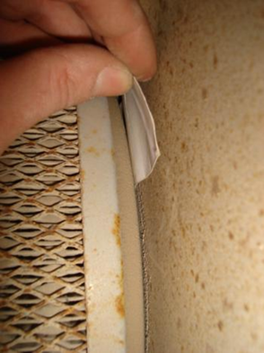
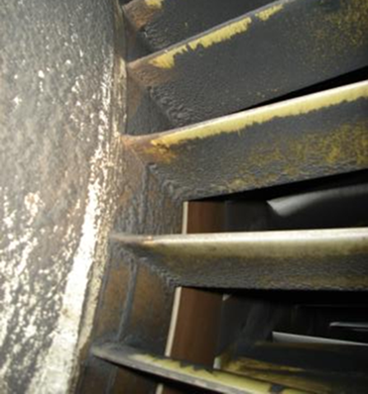
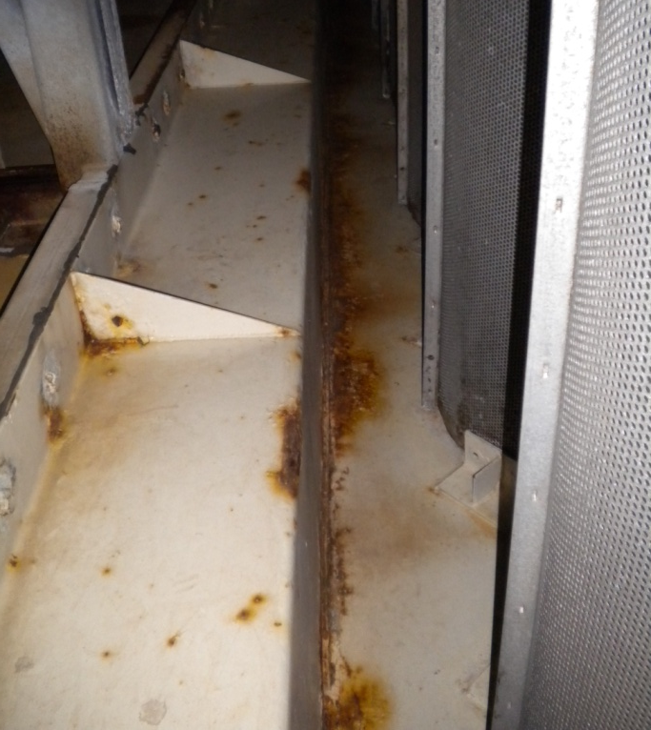
Consideration of the Condition of the Air Inlet Housing & Filters.

Slide 49
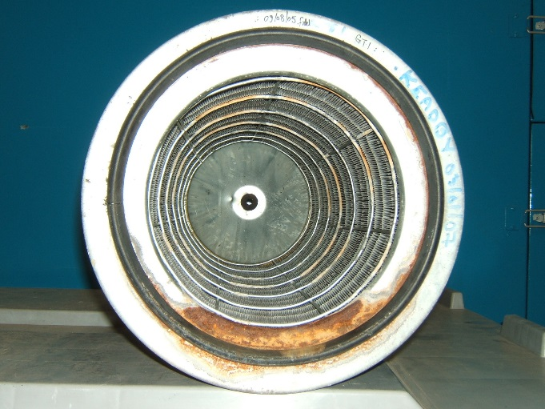
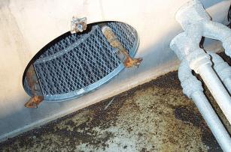
Particle Removal - Liquids - Single stage Filter Configuration
Cartridge
Air flow
If the atmosphere was always dry then air filters would work at there optimum condition but the atmosphere is not always dry.

Slide 50
Options for Snow and Ice (GE)
+ (Most favorable)
0 (Unbiased)
– (Least favorable)

Slide 51
III. Filter Choices #2 - Design Decisions
Subject | Slide Contributor | Relevant decision
Design Decisions
Life Cycle Costs | Clarcor | What factors should be considered besides filter efficiency?
Life Cycle Costs | Southwest | What life cycle costs should be taken into account?
Static Design | Southwest | What shape and size of filter?
Self-Cleaning Filters | Southwest | How do self-cleaning filters work?
Pulsing for Constant Pressure Drop | Gore | What are the advantages of pulsing over static filters?
Pulsing to Eliminate Off-line Washes | Gore | What are the advantages of pulsing over static filters?
Static vs. Pulse | GE | Under what conditions are static and pulse filters most effective?

Slide 52
Evaluate Filters Based on Overall Performance – not just Efficiency
Filtration Efficiency’s impact on compressor health-Filtration News, April 2015.
Clarcor says that based on total performance, which includes turbine maintenance plus pressure loss and filter degradation. The EPA filter is not necessarily the best.
Maintenance of long term turbine health can be offset by
  Operational degradation
  Higher dP spikes
  Unpredictable end of life
  Unplanned outages

Slide 53
Filter Life Cycle Cost Considerations (Southwest)
Initial costs
  Equipment (filters, filtration system, spares filters, instrumentation)
  Installation and commissioning (labor, cost of installation equipment such as cranes)
Energy costs (pulse system for self-cleaning filters)
Operating costs (labor and inspections)
Maintenance costs (replacing filters, repairs, and associated labor)
Downtime (to replace filters, complete offline water washes, anything outside of normal shutdowns for other maintenance)
Gas turbine effects (degradation, performance loss)
Decommissioning and disposal (disposal of filters)

Slide 54
High Efficiency Static Filter Design (Southwest)
There are many different constructions of high efficiency-type filters:
  rectangular,
  cylindrical/cartridge,
  bag filters
Rectangular high efficiency filters are constructed by folding a continuous sheet of media into closely spaced pleats in a rectangular rigid frame.
  Rectangular filters are depth loaded; therefore, once they reach the maximum allowable pressure loss, they should be replaced.
Cartridge filters are also made up of closely spaced pleats, but in a circular fashion
  Air flows radially into the cartridge
  They can be installed in a horizontal or vertical fashion (hanging downward)
  Cartridge filters can be depth or surface loaded

Slide 55
Self-Cleaning Cartridge Systems (Southwest)
Self-cleaning systems operate primarily with surface loaded high-efficiency cartridge filters.
Once the pressure loss reaches a pre-defined level, the filter is cleaned with air pulses.
The pressure of the air pulses ranges from 80 to 100 psig (5.5 to 6.9 barg).
A reverse jet of compressed air (or pulse) occurs for a length of time between 100 and 200 milliseconds.
To avoid disturbing the flow, and to limit the need for compressed air, the system typically only pulses 10 percent of the elements at a given time.
With this type of cleaning, the filter can be brought back to near the original condition

Slide 56
Pulsing Prevents Pressure Peaks (Gore)

Slide 57
Pulsing Eliminates Off-line Washes (Gore)

Slide 58
Static vs. Pulse Filter Options (GE)
+ (Most favorable)
0 (Unbiased)
– (Least favorable)

Slide 59
Filter systems
Multi stage designs
Pre filter options

Slide 60
III. Filter Choices #3 - Multi-stage Designs
Subject | Slide Contributor | Relevant decision
Multi-stage Designs | Southwest | Will more than one type of filter be required?
Pre-filter Options | AAF | Why should pre-filters be used?
Pre-filter Options | AAF | Which option is best and when?
Cartridge/Pre-filter | Gore | Gore offers a cartridge filter with an integral pre-filter.

Slide 61
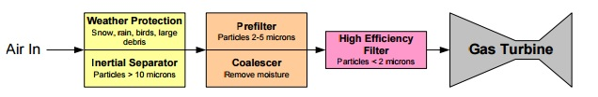
Multi-Stage Filtration Systems (Southwest)
Any gas turbine application typically needs more than one type of filter, and there are no “universal filters” that will serve all needs. So, two-stage or three-stage filtration systems are typically used.
A weather louver can be used first to remove erosive contaminants, rain and snow.
The second stage may be a low to medium performance pre-filter selected for the type of finer sized particles present, or a coalescer to remove liquids.
The third stage is usually a high-performance filter to remove smaller particles less than 2 µm in size from the air.
The arrangement will very based on site specific environmental considerations.

Slide 62
Pre-filter Options (AAF)
If a one-stage high efficiency filter is used, the build-up of large and small solid particles can quickly lead to increased pressure loss and filter loading.
Pre-filters are used to increase the life of the downstream high efficiency filter by capturing the larger solid particles.
Therefore, the high efficiency filter only has to remove the smaller particles from the air stream which increases the filter life.
Pre-filters normally capture solid particles greater than 10 μm, but some pre-filters will also capture the solid particles in the 2 to 5 μm size range.
These filters usually consist of large diameter synthetic fiber in a disposable frame structure.
Bag filters are also commonly used for pre-filters. These offer higher surface area that reduces the pressure loss across the filter.

Slide 63
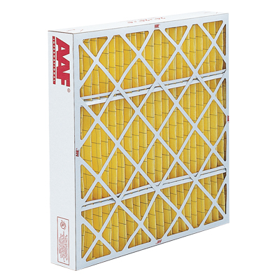
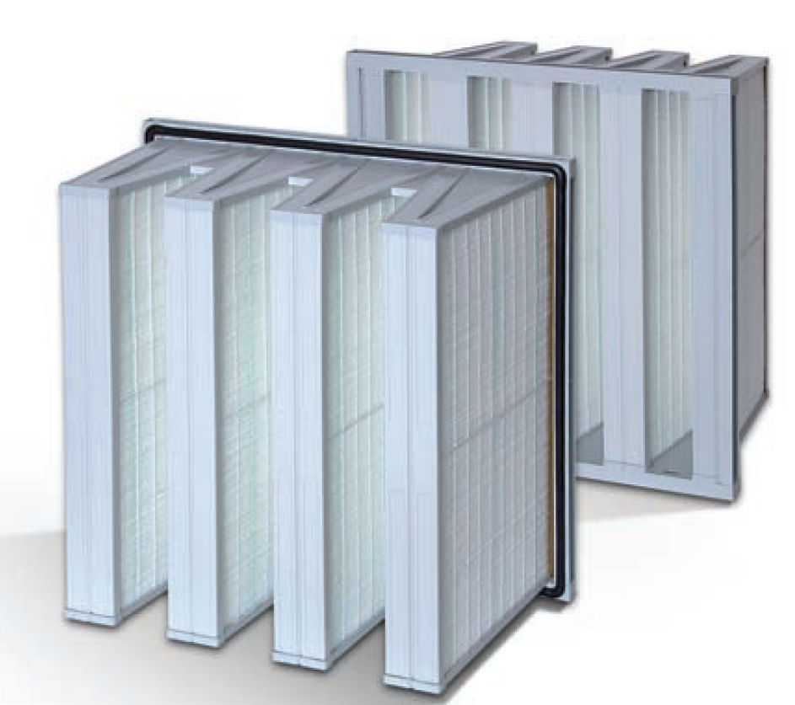
Pre-filter options – Which, where? (AAF)
Panel - AmAir 300GT
Bag-V Bank

Slide 64
Cartridges with Integral Pre-filters (Gore)

Slide 65
III. Filter Choices #4 - Decision Diagrams
Subject | Slide Contributor | Relevant decision
Filter Options | Ahlstrom | What filter options are available?
Selection Based on Operating Conditions | GE | What filter should be selected based on dust loading, remoteness of operation and other conditions?
Selection Based on Environment | GE | What filter systems are recommended for each type of environment?
Selection Based on Environment | GEA | What filter systems are recommended for each type of environment?

Slide 68
Filter Options (Ahlstrom)

Slide 69
Filter Recommendations
Based on Operating Conditions (GE)

Slide 70
Filter Recommendations
Depending on Environment (GE)

Slide 71
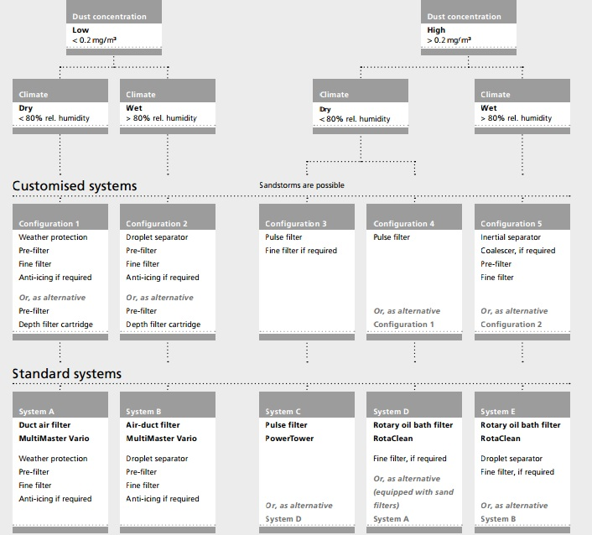
Selection Criteria
for Intake Systems (GEA)

Slide 72
Decision Route – Filter Choices
Webinars (Protected)
Intelligence System Key Words
Date | Recording Title
February 5, 2015 | Gas Turbine Regulatory Drivers 120 minutes
May 15, 2014 | Gas Intake Filters: HEPA or Medium Efficiency 101 minutes
InterWebViewsTM (Free)
Date | Topic
Search Category | Key Words
By Product | Air Filter Air Inlet House
By Company | AAF, Ahlstrom, Clarcor, Donaldson, Freudenberg, Hollingsworth & Vose, GE, GEA, Gore, Midwesco, Nederman
By Topic | Efficiency Humidity Moisture

Slide 73
Components
Support mesh
adhesives

Slide 74
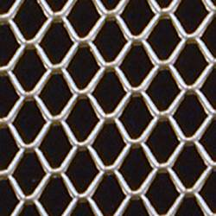
Variety of materials and mesh sizes can be use to support the media
Dexmet polygrid and microgrid products can be used in several gas turbine filter applications including
Internal Core Material: Media Support & Backing
Primary Filtration
Pre-Filters
There is a range of metals and high temperature as well as low temperature plastics available. Pore size can be varied from 25 microns upward. Dexmet is an exhibitor at AFS and wants to explore the expanded use of their materials in the tough offshore, artic an desert environments for the filters. Also they want to match their pore capabilities to the industry needs as it switches to the EPA from the medium efficiency filters

Slide 75
adhesives
Site testing has shown that ensuring efficiency under humid conditions was more challenging than under dry conditions, highlighting the importance of water tightness in a filter to prevent any by-pass. Factors influencing water tightness includes the design around the sealing of the media pack within the filter, and, on static filters, how many sides are glued.
MULTIPLE APPLICATIONS OF GLUE
The latest generation of filters has been moving towards double sealing design where there are multiple applications of glue. Drainage is also critical for water tightness, and features such as vertical pleating and water drains in the frame help by avoiding any water accumulation. If drainage is not achieved quickly enough, the accumulated water will build pressure drop to a point where water will be forced through the media no matter what its efficiency is. It is also important when looking at vertical pleats to ensure that the glue beads are open enough not to reduce the drainage effectiveness.
Henkel- Dan Oberle will be giving a speech Wednesday on adhesives
Franklin Adhesives will be an exhibitor

