Slide 1

The Wastewater Spray Dryer
“The Simple Solution to Zero Liquid Discharge”
Control and Treatment Technology for FGD Wastewater
August 15, 2013
Confidential
Notes:
Today, I’d like to talk about our WSD (Wastewater Spray Dryer) technology for Zero Liquid Discharge.
As you know EPA proposed revisions of the effluent limitations guidelines and standards on 19th April this year.
The effluent guide line says the pollutants of mercury, arsenic, selenium and nitrogen discharged from FGD needs to be treated to stringent level.
This revised guideline would drive requirement of ZLD technologies to meet this stringent limitation.
I believe our WSD technology would be one of your options to meet the effluent limitations guidelines.
Let’s move on to the next slide for our Advatech’s ZLD offerings.

Slide 2
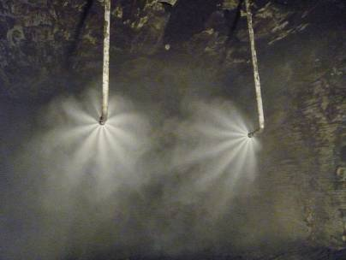
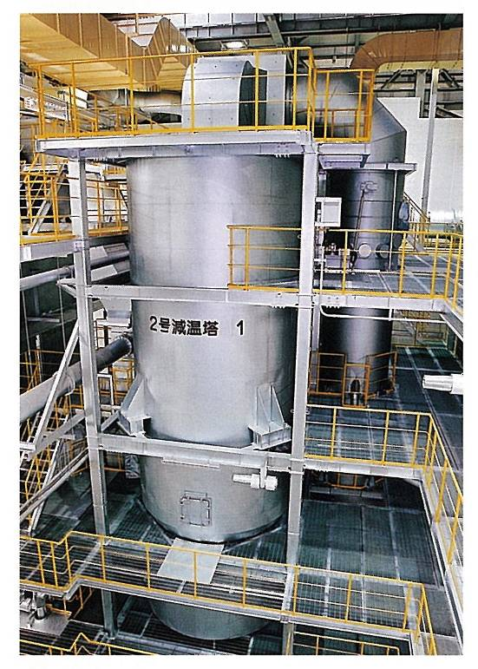
Advatech ZLD offerings
Wastewater Evaporation System (WES)
  Direct injection of wastewater into ductwork
  Salts collected with fly ash in particulate control device
  10 commercial installations w/ 50 yrs of cumulative operating experience
Wastewater Spray Dryer (WSD)
  Patented Process
  Slipstream spray dryer bypassing air heater
  Salts collected with fly ash in particulate control device
  Application of MHI standard gas cooler design & WES experience
    90 commercial installations, 20 years experience
Truly Zero Liquid Discharge Technologies
Confidential
Notes:
2
2
2
Here summarized two Advatech ZLD technologies for WES and WSD.
First, wastewater evaporation system named WES is that wastewater is directly sprayed into ductwork upstream of ESP by two fluid nozzle and wastewater is evaporated by using heat that would otherwise be wasted.
We have total 10 commercial installations in the world.
Second offering is wastewater spray dryer named WSD which is MHI’s patented process.
WSD is arranged slipstream spray dryer bypassing air heater and salts collected with fly ash in particulate control device as well.
WSD applies MHI standard gas cooler design for refused incineration plant and WES experience. The gas cooler has 90 commercial installations with 20 years experience.
I’ll explain WSD in detail next slide.

Slide 3
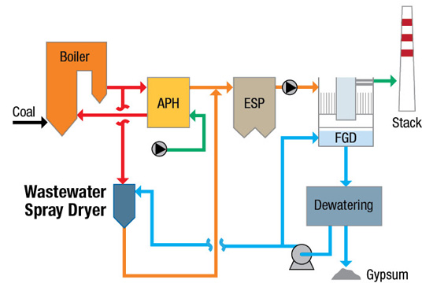
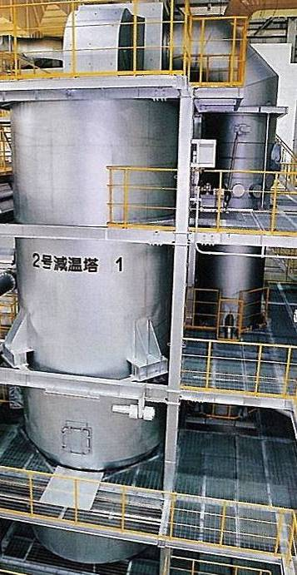
WSD Overview
Advantages
Differential pressure across heater provides motive force for flue gas passing through the WSD (no fan required) Use of flue gas from upstream of the air heater reduces amount of gas required for evaporation FGD wastewater is evaporated in a controlled environment that can be isolated for maintenance/repair Salts & trace elements from wastewater are collected in the existing particulate control device for disposal, etc. with the fly ash
Confidential
Notes:
3
Here is the WSD overview.
FGD wastewater is evaporated in a controlled environment that can be isolated for maintenance and repair.
The Flue gas from upstream of the air heater reduces amount of gas required for evaporation and solidified salts can be collected in the existing particulate control device with fly ash.
Differential pressure across air heater provides motive force for flue gas passing through the WSD so no fan is required.
3

Slide 4
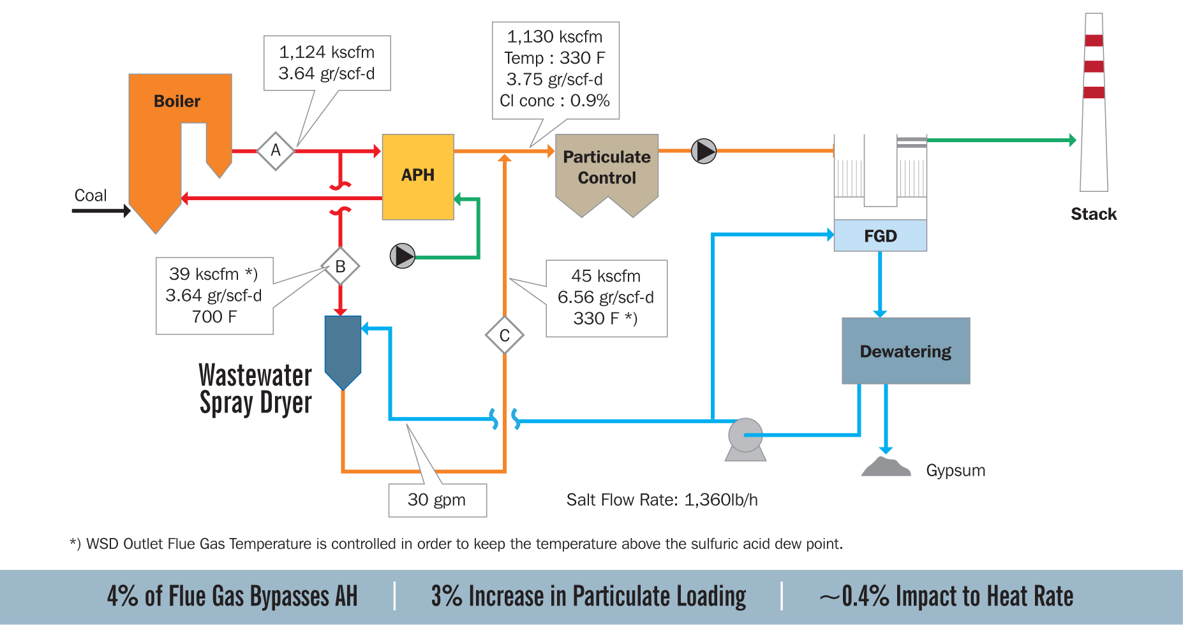
Typical WSD PFD for 500 MW Coal-fired Boiler
4% of Flue Gas Bypasses AH
3% Increase in Particulate Loading; ~0.4% Impact to Heat Rate
Confidential
Notes:
This slide shows typical WSD process flow diagram for 500 MW coal-fired boiler.
30 gpm wastewater liquid sprayed in the WSD and 4% of flue gas bypasses Air Heater is required for evaporation. 3% particulate loading is to be increased at the particulate control device due to dried salts generated by WSD and only 0.4% impact to heat rate.

Slide 5

Possible concerns for WSD technology ??
Evaporation CFD model for the wastewater
  Affect the evaporation by wastewater composition ?
Captured in particulate control device
  Can be corrected by particulate control device ?
Verified by these questions by pilot testing
5
Confidential
Notes:
When we were at design WSD stage, we raised some concerns for WSD technology.
Does wastewater composition such as higher chloride concentration affect to evaporation CFD model ?
Can dried salt generated by WSD be really collected by particulate control ?
In order to answer these questions, we verified them by pilot testing.

Slide 6





MHI’s Droplet Evaporation Model
Droplet
Drying process
1st step: Initial heating up by hot flue gas
2nd step: Evaporation at the wet bulb temperature with elevated boiling point
3rd step: Crust formation that inhibits water evaporation (droplet temperature increases)
4th step: Boiling remaining water
5th step: Drying solid
5th step
Drying
4th step
Boiling
Droplet Temperature
3rd step
Crust Formation
2nd step
Equilibrium Evaporation
1st step
Initial Heating Up
Time
Process of Solution Droplet Evaporation
Droplet Evaporation Model Incorporated into CFD Software
Confidential
Notes:
This is a MHI’s droplet evaporation model which has 5th steps of wastewater evaporation.
1st step is initial heating up by hot flue gas and then evaporation at the wet bulb temperature with elevated boiling point.
At the 3rd step, Evaporation is inhibited with droplet temperature increased during crust formation.
After crust formation, remaining water is boiled and liquid is solidified at the final step.
This droplet evaporation model incorporated into CFD software.

Slide 7
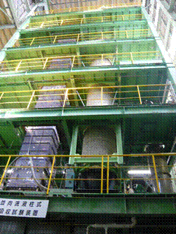

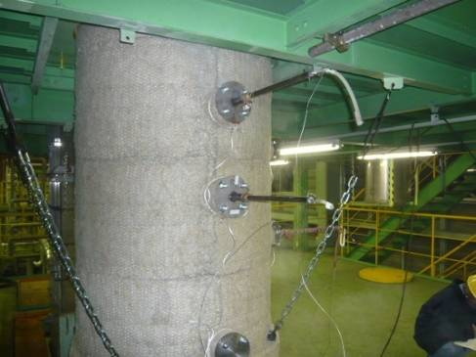
Pilot Testing
Purpose of Pilot Test
Verify the droplet evaporation model
Characterize the dried salt (sampling & SEM)
Heated Simulated Flue Gas
Two-Fluid Spray Nozzle
Solution
Solution Tank
Pump
Atomizing Air Compressor
Schematic Drawing of Pilot Test Apparatus
(Inlet Conditions: 630 scfm; 630ºF)
Photo of Typical Sampling Nozzle
Photo of Pilot Test Facility
7
Confidential
Notes:
This is the pilot testing overview at Hiroshima R&D center.
Approximate 3ft diameter and 30ft tall tower was assembled with two fluid nozzle.
Hot gas temperature was 630 F simulated to AH inlet gas and sprayed solution was simulated to water and typical FGD wastewater.

Slide 8
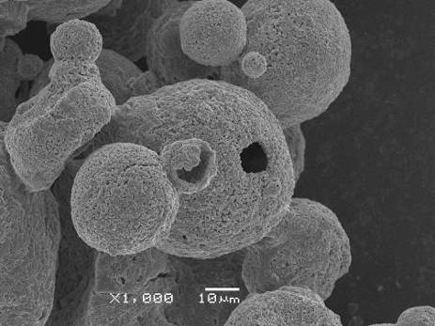
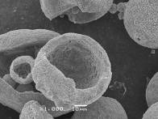
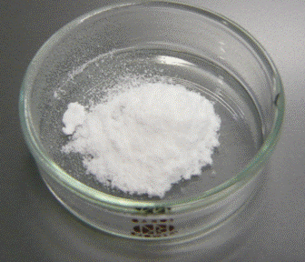
Pilot Test Results
Testing Conditions
Compositions of Salt Solution
Case | Case 1 | Case 2
Liquid Type | Water | Salt Solution
Inlet Flow Rate | 622 SCFM | 628 SCFM
L/G (gal/kacf) | 0.34 | 0.34
Inlet Gas Temp | 631F | 635F
TDS | 101,000 ppm
Chloride | 66,400 ppm
Achieved Complete Evaporation for both cases
Dried Salt Sample
Photo of Dried Salt Sample
SEM Photo of Dried Salt Sample
Dried Salt Particle size : 10 – 60 micron
Dried Salt Generated
Crust Formation Verified
Confidential
Notes:
This is the pilot test results for water and salt solution cases.
Case-1 is just water and Case-2 is salt solution simulated FGD wastewater. The chloride concentration is 66,000 ppm.
Both cases could be achieved complete evaporation and the crust formation was verified for salt solution case.
Dried salt particle size is measured 10 to 60 micron meter.

Slide 9

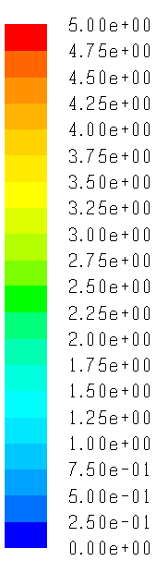
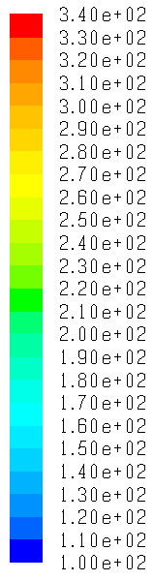
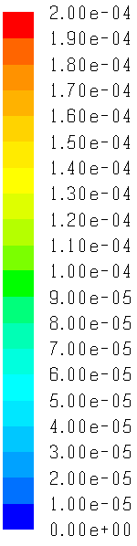
Pilot Test Results – CFD Model Evaluation
CFD Result
Vessel
Vessel
Wall
Vessel
Wall
Center
Wall
Center
Center
Spray Point
Spray Point
Spray Point
Temp [Deg F]
210
650
[Wet Salt]
650F
200
um
650F
200
16.5 fps
16.5 fps
[Semi-Dry Salt]
micron
[Dry Salt]
CFD
Test data
210F
210F
0
0
0
0
Droplet Size
Gas Velocity
Gas Temperature
Droplet Size
Gas Velocity
Gas Temperature
Distribution
Profile
Distribution
Profile
Both gas temp. and moisture content profiles in pilot vessel agreed with CFD model
Moisture content of collected dried salt also agreed with CFD model
Droplet Evaporation Model effectively simulated evaporation process in WSD system
9
Confidential
Notes:
Here is the CFD model evaluation for the pilot testing.
Both gas temperature and moisture profiles in pilot vessel agreed with CFD model
and moisture content of collected dried salt also agreed with CFD model.
Thus from the CFD model evaluation, droplet evaporation model effectively simulated evaporation process in WSD system.

Slide 10
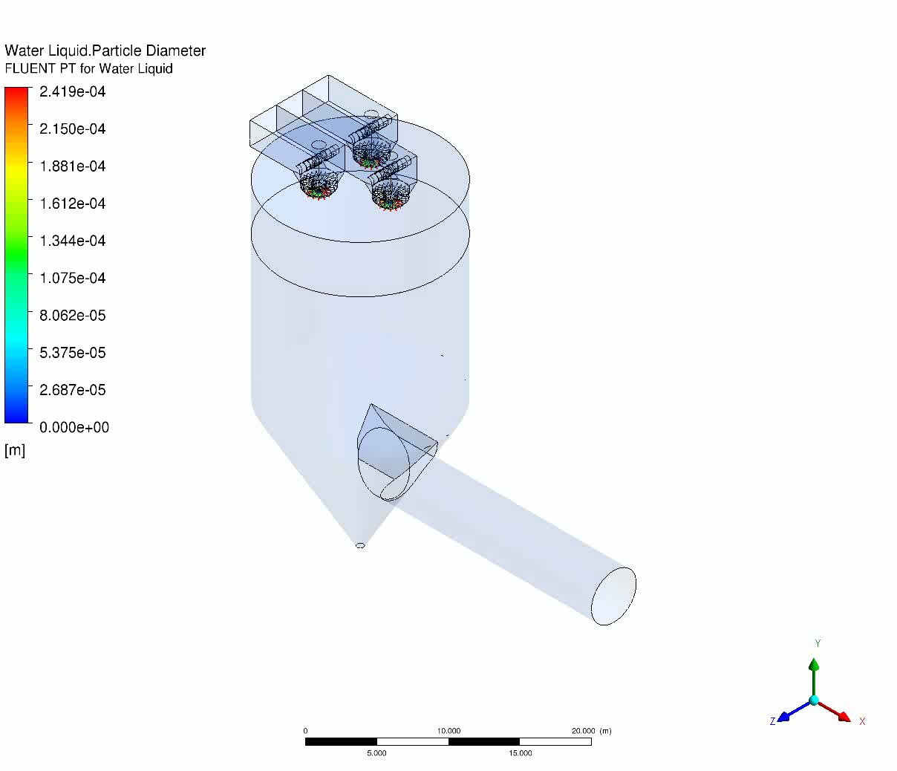
Typical Simulation for Droplet Tracing
Larger Scale WSD for High-Cl Coal Application
Rotary Atomizer (200 GPM)
10
Confidential
Notes:
Here is the typical simulation result movie for droplet tracing. We can understand sprayed liquid can be evaporated in the WSD tower.

Slide 11
Questions Cleared Up by Pilot Testing
Evaporation model simulates evaporation process
  Gas temp., moisture content profiles in pilot testing agreed with CFD model
The Dried Salts should be Easily Captured by the Existing Particulate Control Device
  Dried salt particle size in range of fly ash (10-60 um)
11
Confidential
Notes:
By pilot testing and CFD simulation with evaporation modeling, questions could cleared up for the WSD technology.
Gas temperature, moisture content profiles in pilot testing could agree with CFD model so evaporation model in the CFD could simulate evaporation process. The chlorides in the FGD wastewater form a filterable particulate.
Since dried salt generated with rage of fly ash particle size, the dried salts should be easily captured by existing particulate control device.

Slide 12
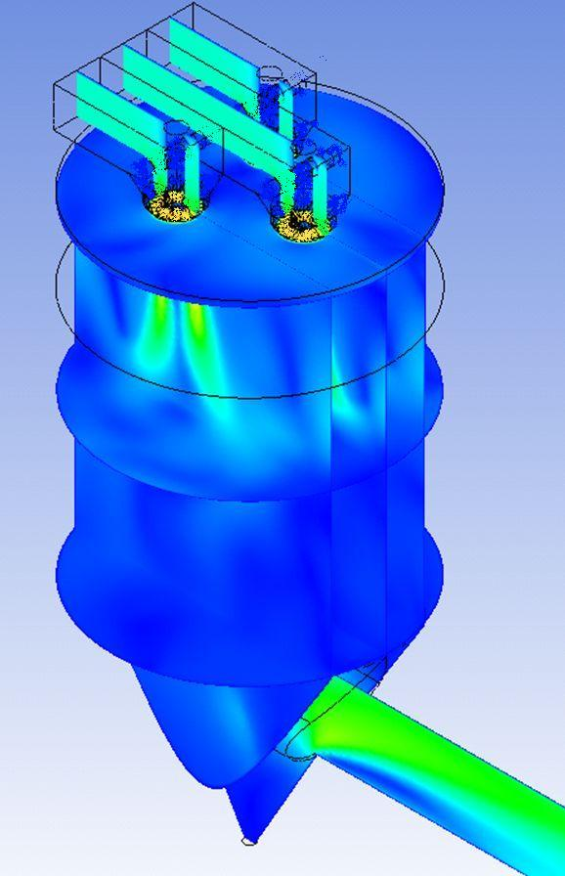
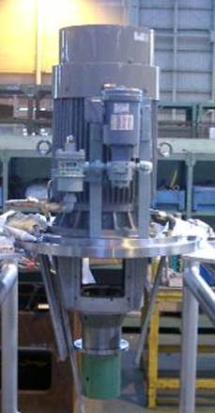
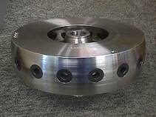
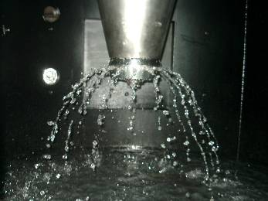

Commercial Design of WSD
Applied CFD model for commercial WSD design
11.5’ dia.^{*)}
29’ Height^{*)}
Small Scale WSD for Low-Cl Coal Application (11 GPM)
Larger Scale WSD for High-Cl Coal Application
(200+ GPM)
Larger Scale WSD is Commercially Available
Confidential
Notes:
Now we can apply CFD model for commercial WSD design.
Left side is for the small capacity WSD for lower chloride coal application and two fluid nozzle is applied.
Right side shows larger scale WSD for high chloride coal application and rotary atomizer is used for the fine liquid spray.

Slide 13
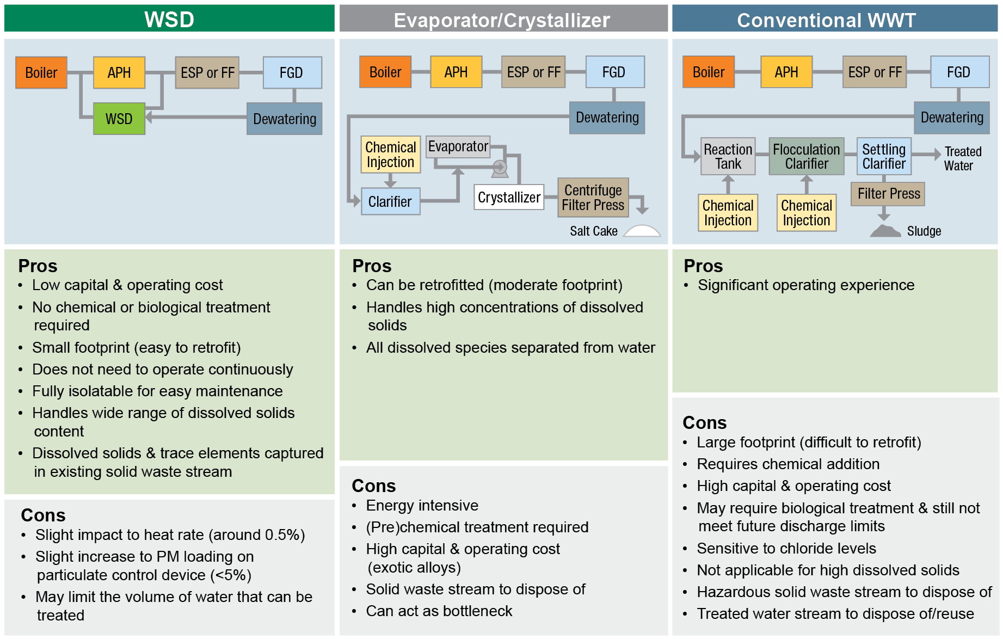
Comparison of WSD to Traditional WWT
13
Confidential
Notes:
Let’s move on the comparison of WSD to traditional wastewater treatment.
WSD is the most simple and small foot print than the others.
Dried salts can be collected by the existing control particulate control device.
WSD has a low capital and operating cost than the others.
Since dryer is applied bypassing from main process line, WSD does not need to operate continuously and fully isolatable for easy maintenance.

Slide 14
Summary
Patented WSD has been developed based on years of experience in the design / operation of WES and Flue Gas Cooler, and validated through pilot testing and CFD modeling
Due to its simplicity, the WSD is one of the most economically attractive ZLD options
  Approximately 1/10th the cost of traditional WWT
  Uses waste heat to evaporate the wastewater stream
  Salt particles are collected in the existing particulate control device so a new waste stream is not generated
WSD can be applied for wide range of wastewater and even be used to reduce the amount of wastewater that goes to a more traditional wastewater treatment process
For more information, please visit www.AdvatechLLC.com
Confidential
Notes:
I’m ending my presentation, this is the summary for the WSD system.
Patented WSD technology has been developed based on years of experience in the design and operation of WES and Flue Gas Cooler and validated through pilot testing and CFD modeling.
Due to its simplicity, the WSD is one of the most economically attractive ZLD options.
WSD is approximately one tenth the cost of traditional WWT, can uses waste heat to evaporate the wastewater stream, and salt particles are collected in the existing particulate control device so a new waste stream is not generated.
WSD can be applied for wide range of wastewater and even be used reduce the amount of wastewater that goes to a more traditional wastewater treatment process.
Thus we believe WSD is the most attractive option for eliminate all pollutants for stringent effluent limitations.
For more information, please visit www.AdvatechLLC.com
Thank you for your attention.

Slide 15
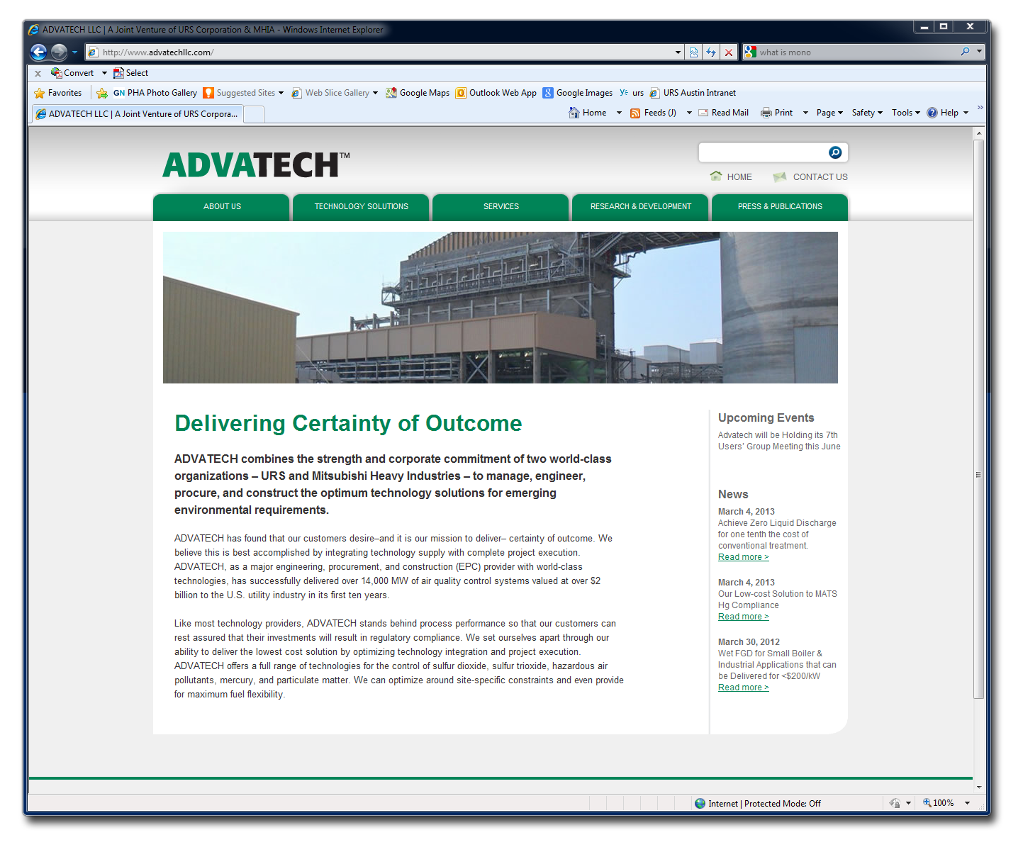
QUESTIONS?
15
Confidential
Notes:
Thank you for your attention.
Do you have any questions ?

