Slide 1
SOLUTIONS TO REDUCE TOTAL COST OF OWNERSHIP UTILIZING HIGH EFFICIENCY FILTER MEDIA presented by TDC Filter & Nordic Air Filtration
Mar 14, 2012

Slide 2
Benefits of Using High Efficency Filters
Problems
Harsh Environments
Salt/water
Cooling tower drifting
Frost
Reduced power output
Frequent Shut Downs
Solutions
Salt/Water Repellent Media
High Efficiency Filter Media
MERV16 – TWHE & TW-NANO
E12 - TWUE, TWXE
Benefits
Lower Operating Cost
Increased Power Output
Reduced Downtime due to Waterwash
Reduced Compressor Fouling
Increased filter life
Reduced Total Cost Ownership

Slide 3
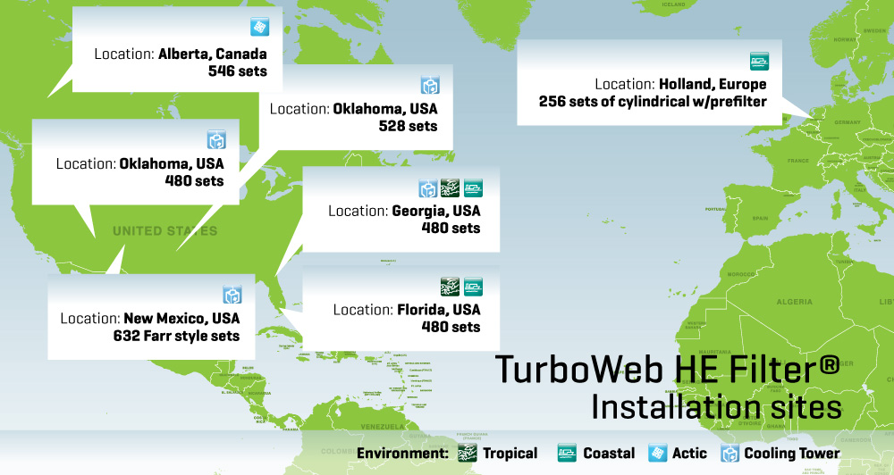
Selected Global Installation Sites TurboWeb HE Filter

Slide 4
TDC Media can Handle Challenging Enviroments Standard to Premium Media
Environments
Desert: Hot & Dry with heavy sand blowing
Desert-Coastal: Hot with corrosive moisture, heavy sand blowing, high humidity, occasional heavy fog
Arctic: Dry air, snow, frost
Urban/Industrial: Polluted air, high level of particles, hydrocarbon
Marine, Coastal, Offshore, Tropical & Semi-Tropical: Corrosive moisture, high humidity, occasional fog, frequent rain, potential for salt carryover.
Media Type
Blended Cellulose
Synthetic
Nano Treated Media
ePTFE Membrane Treated Media

Slide 5
Case Study: Cooling Tower Challenge Superior Initial Efficiency Led to Higher GT Performance
Problems
Moisture Drift from Cooling Tower
Water Penetration through Filter
Frequent Shut Down
Offline Waterwash
Compressor Fouling
TWHE
High Efficiency Filter Media
Benefits
Increased Power Output
Cleaner Turbine Blades Resulting in Longer Life
99.5 – 99.9% Efficiency for Removal of Submicron Particulates

Slide 6
Case Study: Cooling Tower Challenge MERV16 Rated Filter resulted in Reduced Waterwash
Benefits:
2 MW more power output
than using MERV 15 filter
Increased turbine availability
Lower maintenance costs
Eliminated Waterwash
6

Slide 7
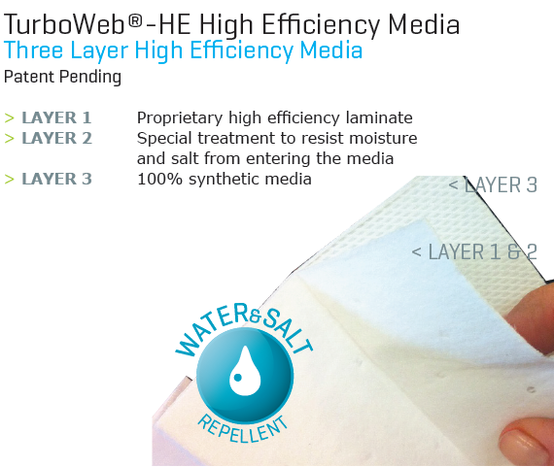
Case Study: Coastal Salt and Water Environment & Cooling Tower Challenge Superior Initial Efficiency Led to Higher GT Performance
Problems
Salt + Sea water moisture causing corrosion of turbine blades
Moisture Drift from Cooling Tower
Frequent Shut Down
Offline Waterwash
Compressor Fouling
TWHE
High Efficiency Filter Media
Benefits
Prevent Salt + Water Penetration
Lower operating pressure drop
Lower cost of turbine maintenance

Slide 8
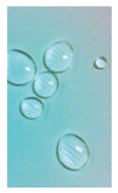
Case Study: Coastal Salt and Water Environment & Cooling Tower Challenge Independent Lab Test Demonstrated Superior Water Repellence
Water Repellent Media

Slide 9
TDC High Efficiency TWHE Media Exceeded GE GT filter spec for water removal efficiency

Slide 10
Next-Generation TDC Media Enhanced benefits by utilizing ”E12 Class” media
TDC is proud to introduce our next generation media, “E12 Class” with the following benefits:
Increased Power Output (up to 6%)
E12 filter can replace existing filter without retrofit of intake housing
Zero off-line water wash
> 99.5 %

Slide 11
For More Infomation on our High Efficiency Media Contact TDC:
Track record and expertise to solve your GT operational problems
Full line of high-efficiency media with proven results.
MERV16 – TWHE & TW-NANO,
E12 - TWUE, TWXE
SALES CONTACT MANUFACTURING LOCATIONS

