Slide 1
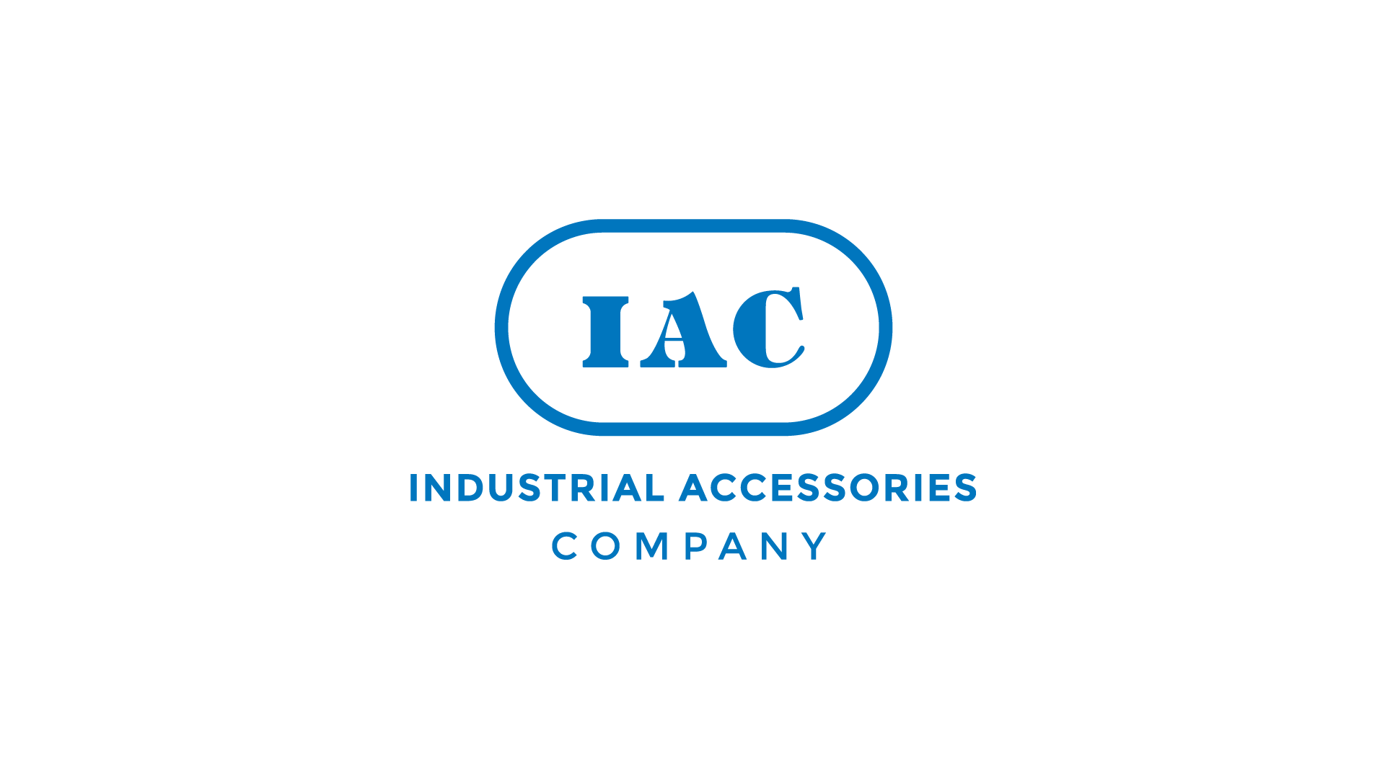
Frac Sand Plant Optimization Bob Carter, President 1-800-334-7431

Slide 2
Characterizing Optimization
Characterizing Optimization
Operational Performance (Short Term – vs – Sustained)
Mining
Wet plant
Dry plant
Load out
Fiscal Optimization
Personnel – Hiring and Retention
Utilities – Power and Water
Capital Cost – Growth and Annual
Operational Cost Per Ton
Maintenance Cost Per Ton
Fiscal Projections and Street Expectations
Understanding Impact Metrics
Mine Feed Gradation
Weather and Moisture
Change in Product Demand
Developing Tools That Drive Optimization In Each Category

Slide 3
Steps To Optimization – Operate System Under Varying Conditions
Understanding and Validation of Operating System
Dry Plant - Example
Understand Current Design and Key “Control Points” in the system
Dryer Capability – Actual Operation to Validate Capability
Profile WIP Piles on Moisture and gradation
Prove out Maximum Capacity with Varying Moisture
Log Data on Pressure Drops, Temperature Profiles, etc.,
Screener Capability
Develop Data Metric Across Screeners
Quality Impact fn (feedrate, gradation)
Screen Configuration fn (gradation)
Conveyor and Bucket Elevator Capacity
Ensure capacities fn (feedrate, gradation)
Dust Collection
Waste Handling Capacity f(feedrate, gradation)
Pressure Drop, Dryer negative pressure fn (feedrate, gradation)
ID fan performance curve fn (feedrate, gradation)

Slide 4
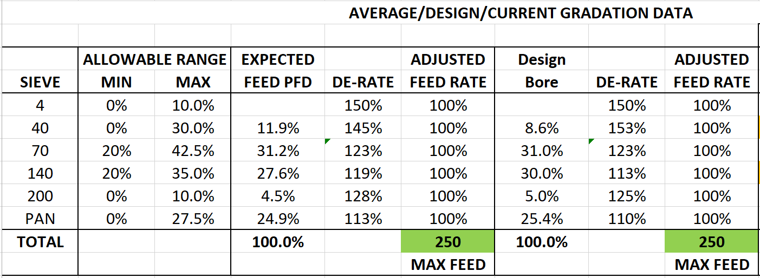
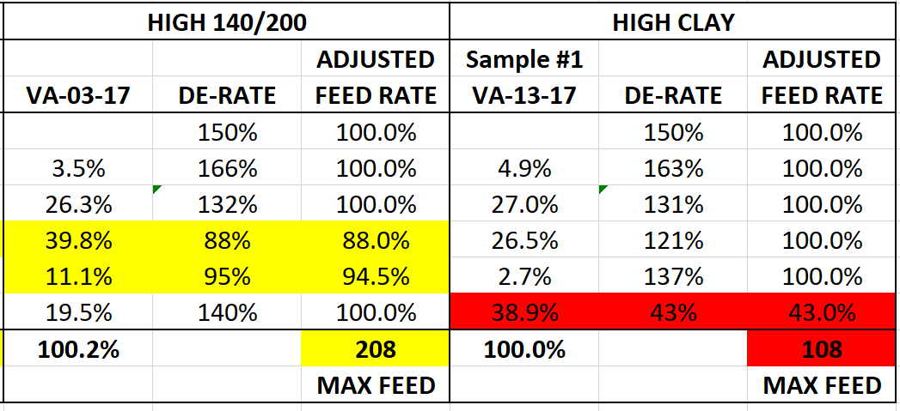
Steps To Optimization – Characterization of Input
Characterization of Input
Wet Plant fn(mine feed) - Example
Understand Current Design and Key “Control Points” in the system
Mine Feed Variations Changes Maximum Throughput
High Waste Material Impacts Hydrosizer and Clarifier
Heavy 100 mesh or 4070 Can overload Cyclones
Heavy Fines Percentage can impact UFR or Clarifier

Slide 5
Steps To Optimization – Implement Operational, Control, Data Analytics and Reporting Metric
Improved “Control Point” Performance
Process & Procedural Changes
Develop Analytical Tools Which Optimize Production at Varying Process Conditions
Develop Advanced Controls Package To Manage Change in Process Conditions
Advanced Trend and Control Charts to Characterize Performance
Increased instrumentation and lab data.
Lag time reports to evaluate cause/effect timelines for change.
Re-design and Retrofit
Minimize Pinch Points with Re-design and Retrofit
Develop Capital Strategy for Optimization
Implement Change and Measure Progress
Measure and Report Progress at the Front Line To Drive Ownership
Measure and Report Performance by Individual, Crew and Business Unit
Develop Evaluation Teams around Continuous Improvement
Involve the Front Line on Growth Intiatives

Slide 6
Steps To Optimization – Update Financial Models and Capital Improvement Plans
Implement Change In Focus and Operational Methodology
Target Production Levels Need to Be Achievable and Sustainable
Identify Mine Plan and Validate Actual Feed To Adjust Operating Parameters
Issue Production Plan Around Sustained Operation at Target Production Levels
Factor in Weather or Other Known Pinch Points Outside of Direct Control
Modify Predictive Models
Factor Improvement in Current Control Points over Time
Reduce Costs of Utilities and Unplanned Failure
Factor in Improvement From Retrofit and Capital Improvement Processes
Share Results At All Levels
Recognize Improvement Through Sustainable Objectives
Retain, Train and Motivate Workforce Through Success
Post Performance Against Goal in the Workplace
Develop Plan to Drive to The Next Sustainable Level
Success Comes Through Steps, Focus and Commitment. IAC is Committed To Changing the Future Through The Whole Process From Design, Construction, Startup, Data Analytics, Process Optimization and Long Term Operational Support. We win Together!

Slide 7
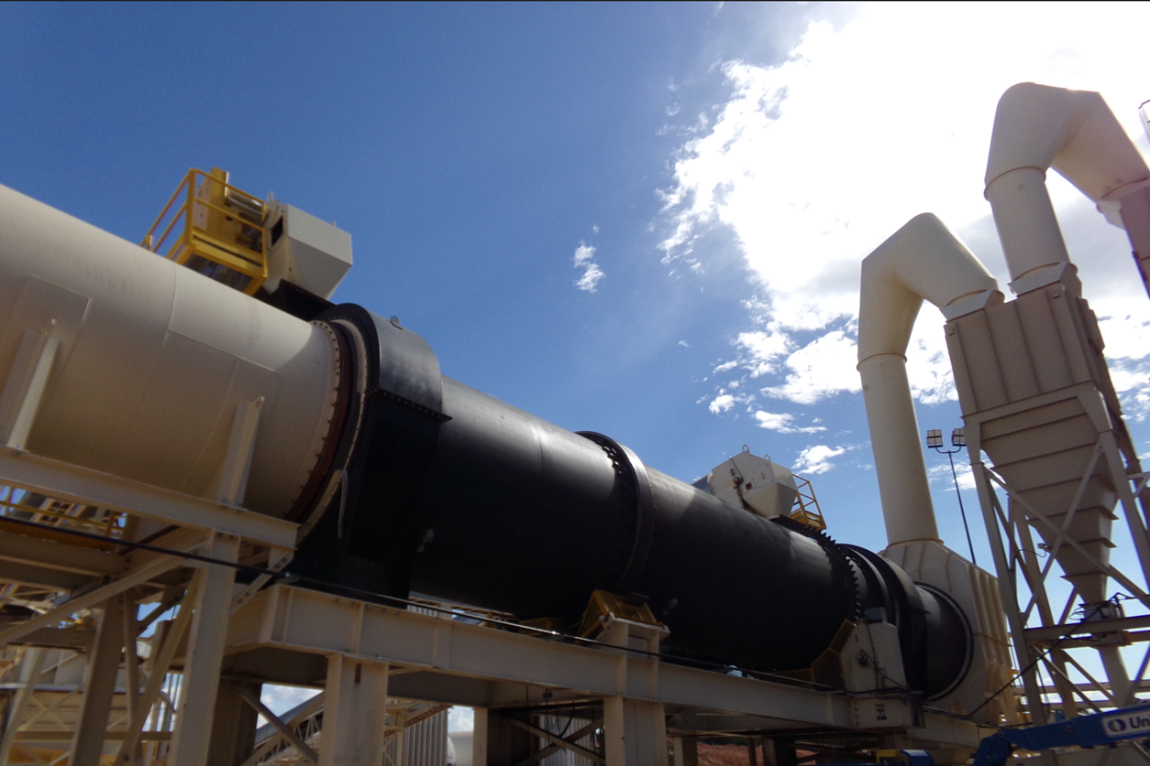
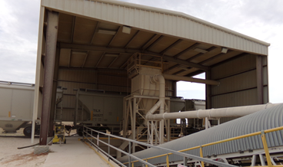
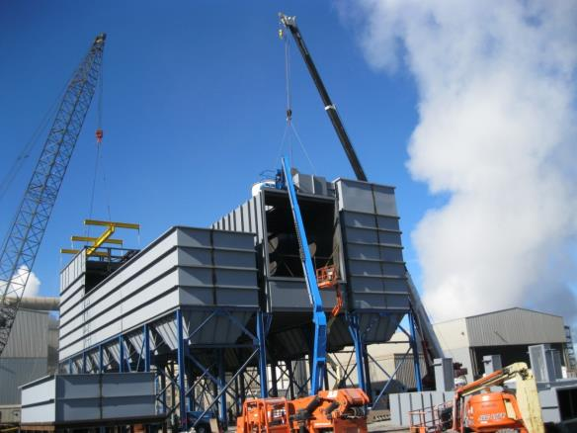
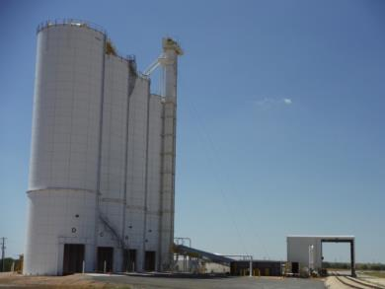
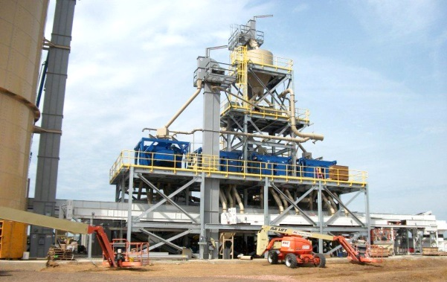
IAC – EPC, Support Services, Advanced Control, Data Analytics and Optimization Capabilities
Patented Dryer/Cooler
Rail Loadout
Dust Collector OEM
IAC can Optimize or Design Build Any of These Facilities
Frac Sand Plant – Design & Install
Transload Facility

Slide 8
THANK YOU
INDUSTRIAL ACCESSORIES COMPANY
4800 Lamar Avenue
Mission, KS 66202
800.334.7431
www.iac-intl.com

