Slide 1

Oil and Gas
Speech by Bob McIlvaine
Valve World Expo June 25 2013
McIlvaine Company
Northfield, IL

Slide 2
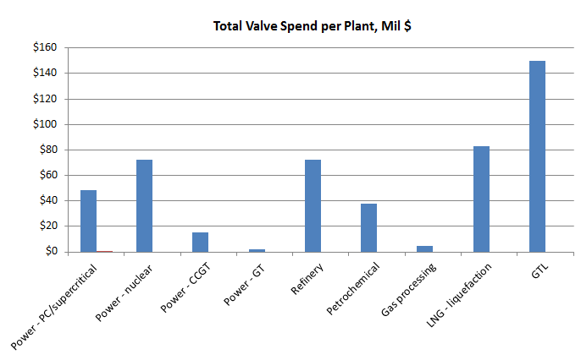
Thousands of Projects Worth Hundreds of $ Billions in Booming Oil and Gas Industry
the number of opportunities in the oil and gas sector ranges from a few thousand to over one million. At the top end there are single projects where the investment will exceed $10 billion.

Slide 3
Hundreds of Active Projects in $19 Billion Canadian Oil Sands Market
There are hundreds of active capital investment projects in the oil sands sector in Western Canada. Last year investment was more than $19 billion with even greater expenditures on the horizon..
The investment is not only for expansion of the total production, but also for environmental improvements at existing facilities. The 2012 expenditures exceeded those in any of the last four years. To meet the expansion from 1.7 to 3.7 million bbl/day by 202l, will require annual expenditures twice the $19 billion spent last year.
The investment in new facilities comes in multibillion dollar chunks. For example, Sunshine Oilsands Ltd. has budgeted about US$3.5 billion for capital investment in its Canadian oil sands projects.

Slide 4
The expenditures to improve the environment are significant. The Quest Carbon Capture and Storage Project will reduce CO₂ emissions from the Athabasca oil sands operation by 35 percent, or more than one million metric tons a year.
The Scotford upgrader plant near Edmonton, Alberta, processes bitumen into synthetic crude oil. The steam-methane reformer units at Scotford produce hydrogen for upgrading bitumen, a process that releases carbon dioxide. Quest will capture CO₂ from Scotford using an amine solvent, a liquid comprising water and amines, then transport it via an 80 kilometer underground pipeline to a storage site north of Shell’s Scotford facility to the northeast of Fort Saskatchewan, Alberta.
Captured CO₂ will be injected more than two kilometers underground into a porous rock formation called the Basal Cambrian Sands, which is located beneath layers of impermeable rock.
Shell Canada executed a contract with Fluor Corp for engineering, procurement and construction (EPC) of the Quest project. Fluor Corp total cost of the project is estimated at USD1.35 billion.

Slide 5
Valve demands for unconventional oil and gas
Development of unconventional oil & gas generally reflects the following differences from conventional fossil energy sources:
  More offshore activity for oil
  More onshore activity in deep shale formations for gas
  Deeper wells (10,000 feet and more)
  Horizontal drilling with hydraulic fracturing
  Higher well pressures
  Increased chemical and water requirements

Slide 6
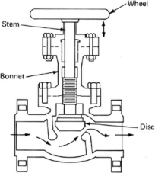
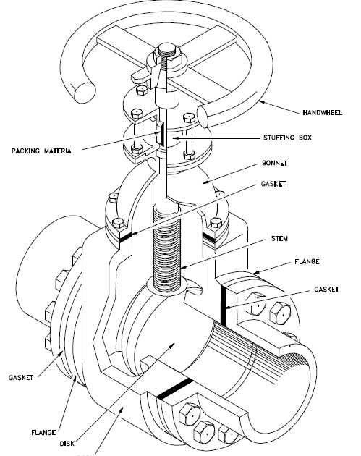
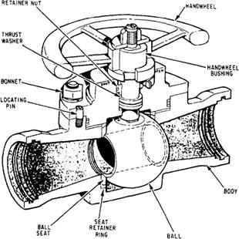
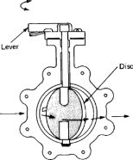
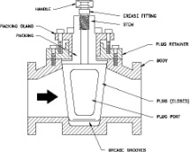
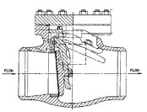
Valve Types
The globe valve is a multi-turn valve commonly used for flow regulation in many different applications. It is not generally used for shutoff service, which is better served by gate valves.
The gate valve is a multi-turn valve commonly used as an isolation valve. It is not generally considered a control valve.
The ball valve is ¼-turn valve commonly used in pipeline applications, as well as many others for tight shutoff and isolation.
The butterfly valve is a ¼-turn valve commonly used in water and cryogenic LNG applications as well as others for tight shutoff and isolation. It is not typically applied on pipelines because it is not “piggable”, and not certified by applicable API standards for pipeline duty.
The plug valve is a quarter turn valve that is similar in function to a ball valve. It is widely used in many refinery applications.
The swing check valve is an auto-actuated valve that finds many applications, including in pipeline, refinery, and compressor applications.

Slide 7
Valve types for Oil and gas 3

Slide 8
Upstream Well head valves
Each wellhead generally includes an assemblage of valves commonly referred to as the “Christmas tree”.
Valve functions include: directing oil and gas from the well to further processing; shutting down or “killing” the well; capping off the well; and injection of various chemicals for well stimulation and enhanced oil recovery (EOR).
Due to the sheer number of wells drilled per year, the Upstream market generates substantial valve revenues.
The total market value for wellhead valves is estimated at just under $1-billion per year, worldwide. The most prevalent valve type is the gate valve, with applications for check valves as well.

Slide 9
Valves for Midstream pipelines 1
Pipeline applications include periodically spaced isolation valves for segmenting the pipeline in the event of a leak or need for other service.
These valves are typically full-ported gate or ball valves that provide low pressure drop when fully open, tight shutoff when closed, and full porting to permit pipeline pigging.
Pigging is a process for sending inspection gauges and pipe cleaning equipment through a pipeline.
Pipeline valves are large valves to accommodate pipe diameters from 6” for gathering lines around the well to 48” and larger for interstate pipelines.

Slide 10
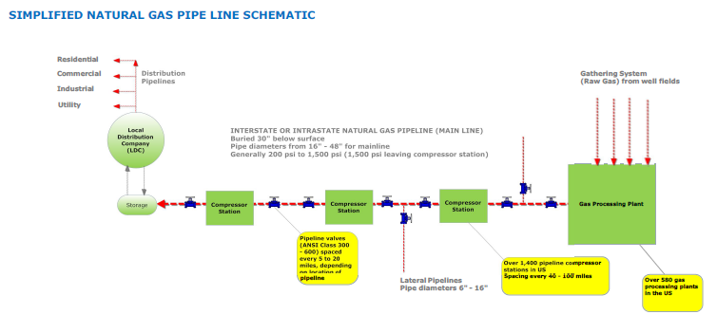
Application
Natural Gas Pipeline
Natural gas main pipeline valves are generally sized 16” to 48”, ANSI Class 300 to 600 (1,440 psi working pressure, max), provide leak-tight closure, and conform to API 6D. Note: Butterfly valves are not often installed in this application because they are inherently not “piggable” , and are not within the scope of API 6D.

Slide 11
Valves for Compressor Stations: 1
Pipeline applications also include compressor stations, situated approximately every 50 miles for gas pressure boosting, gas dehydration, and gas filtration to remove pipe residue and other gas contaminants.
The compressor station typically includes on average 3 to 4 compressors (some large stations can include up to 20 compressors), with each rotating compressor provided with an anti-surge valve to protect the compressor against damage in the event of system upset.
The anti-surge valve is a critical service valve because it protects a compressor that can cost up to $1-million, each. Valve requirements include high capacity, extremely fast operation (full stroke in a fraction of a second), fail-safe open operation, and noise attenuation

Slide 12
Valves for Compressor stations 2

Slide 13
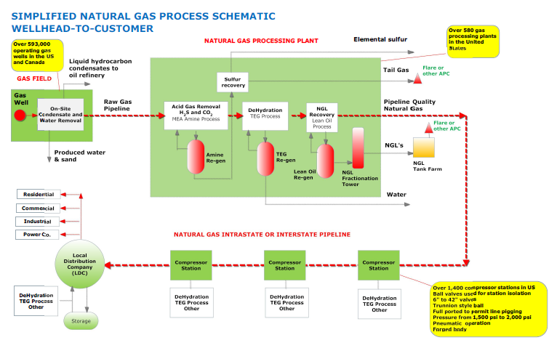
Application Overview
Natural Gas Process Diagram

Slide 14
Oil & Gas
(gas processing)
Gas processing is active in many regions, but most particularly in the United States to manage the growth in shale gas production. Other countries with notable activity in gas plant construction include Canada, Qatar, Saudi Arabia, and UAE. The numerous plants planned or under construction in the US are tending toward the smaller regional plants in the range of 200 mcfd or less (there are exceptions). Middle East plants are typically on a larger scale.
The Total Investment Value (TIV) for a gas processing plant in the range of 200 mcfd typical in the US is on the order of $150-million per plant.
Plant Type | Output Capacity per Plant | Output Capacity, Unit of Measure | Investment Cost per Unit of Measure, Mil $ | Total Plant Investment Value (TIV), Mil $ | Total Valve Spend per Plant, % of TIV | Total Valve Spend Per Plant, Mil $ | Valve Function (% of Valves Per Function) |  | Valve Spend Per Valve Type, % of Plant TIV
 |  |  |  |  |  |  | Control | On/Off, Isolation, Bypass | 1/4 Turn |  |  | Multi-Turn |  |  | Press Relief | Check
 |  |  |  |  |  |  |  |  | Ball | Butterfly | Plug | Gate | Globe | Choke
Gas processing | 200 | mcfd | $0.750 | $150 | 3.0% | $5 | 20.0% | 80.0% | 1.140% | 0.435% | 0.240% | 0.450% | 0.600% | 0.015% | 0.060% | 0.060%

Slide 15
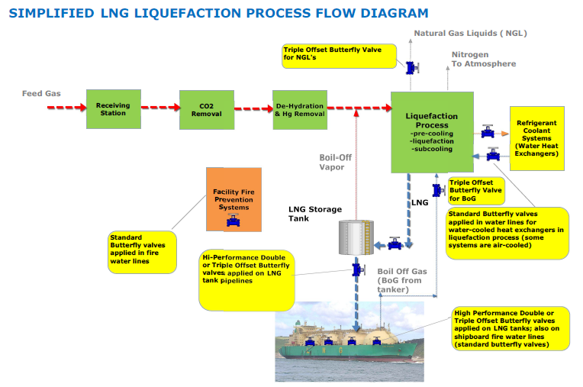
Application
LNG Liquefaction (pipeline, fire service, cooling)

Slide 16
Oil & Gas
(LNG)
LNG production is growing significantly, primarily as a means to get natural gas supplies to energy thirsty Asian markets including Japan, China, and India that have not yet developed local shale gas reserves or coal bed methane to the extent as in the United States and Australia. The shutdown of all nuclear power in Japan, and the “second look” being taken even in China relative to nuclear power are major drivers.
The Total Investment Cost (TIV) for a typical LNG liquefaction plant is on the order of $8-billion per plant.
Plant Type | Output Capacity per Plant | Output Capacity, Unit of Measure | Investment Cost per Unit of Measure, Mil $ | Total Plant Investment Value (TIV), Mil $ | Total Valve Spend per Plant, % of TIV | Total Valve Spend Per Plant, Mil $ | Valve Function (% of Valves Per Function) |  | Valve Spend Per Valve Type, % of Plant TIV
 |  |  |  |  |  |  | Control | On/Off, Isolation, Bypass | 1/4 Turn |  |  | Multi-Turn |  |  | Press Relief | Check
 |  |  |  |  |  |  |  |  | Ball | Butterfly | Plug | Gate | Globe | Choke
LNG - liquefaction | 10 | mtpa | $830 | $8,300 | 1.0% | $83 | 20.0% | 80.0% | 0.350% | 0.410% | 0.010% | 0.105% | 0.080% | 0.005% | 0.020% | 0.020%

Slide 17
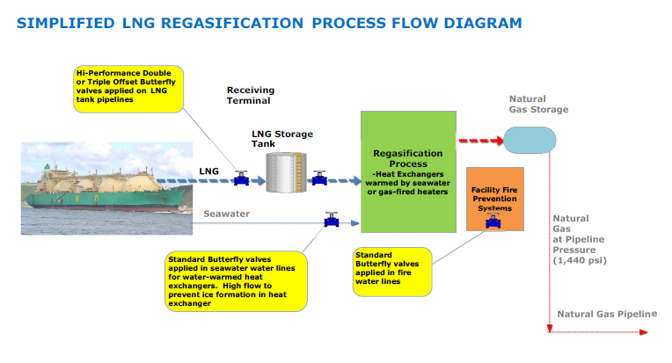
Application
LNG Re-gasification (pipeline, tank isolation, fire service, LNG warming)

Slide 18
Oil & Gas
(refinery)
Refinery activity is growing, both in terms of new plant builds, and especially in terms of plant expansions to handle heavier (lower grade) crude, natural gas liquids (NGL’s), and additional delayed coker units and hydro-treating to provide higher grade fuels. Even though the number of refineries has been in decline for years as a result of consolidations (principally in the US), total refining capacity has increased in the US and worldwide.
The Total Investment Value (TIV) for a refinery of 150,000 bpd output is on the order of $3.5-billion per plant. New-plant construction particularly in the Middle East and Asia trends toward larger plants in the range of 300,000 to 500,000 bpd.
Plant Type | Output Capacity per Plant | Output Capacity, Unit of Measure | Investment Cost per Unit of Measure, Mil $ | Total Plant Investment Value (TIV), Mil $ | Total Valve Spend per Plant, % of TIV | Total Valve Spend Per Plant, Mil $ | Valve Function (% of Valves Per Function) |  | Valve Spend Per Valve Type, % of Plant TIV
 |  |  |  |  |  |  | Control | On/Off, Isolation, Bypass | 1/4 Turn |  |  | Multi-Turn |  |  | Press Relief | Check
 |  |  |  |  |  |  |  |  | Ball | Butterfly | Plug | Gate | Globe | Choke
Refinery | 150,000 | bpd | $0.024 | $3,600 | 2.0% | $72 | 20.0% | 80.0% | 0.260% | 0.200% | 0.900% | 0.290% | 0.200% | 0.010% | 0.040% | 0.100%

Slide 19
Oil & Gas
(petrochemical)
Petrochemical new-plant construction and plant expansions are ongoing in several countries, but particularly in Algeria, China, India, Iran, Saudi Arabia, Singapore, and Venezuela. This reverses a petrochemical oversupply from just several years ago. Primary chemicals are ethylene, but also propylene, benzene, and others.
The Total Investment Value (TIV) for a typical petrochemical plant is the order of $3.5-billion per plant for a 1.5 mtpa output.
Plant Type | Output Capacity per Plant | Output Capacity, Unit of Measure | Investment Cost per Unit of Measure, Mil $ | Total Plant Investment Value (TIV), Mil $ | Total Valve Spend per Plant, % of TIV | Total Valve Spend Per Plant, Mil $ | Valve Function (% of Valves Per Function) |  | Valve Spend Per Valve Type, % of Plant TIV
 |  |  |  |  |  |  | Control | On/Off, Isolation, Bypass | 1/4 Turn |  |  | Multi-Turn |  |  | Press Relief | Check
 |  |  |  |  |  |  |  |  | Ball | Butterfly | Plug | Gate | Globe | Choke
Petrochemical | 1.5 | mtpa | $2,500 | $3,750 | 1.0% | $38 | 20.0% | 80.0% | 0.310% | 0.100% | 0.200% | 0.145% | 0.200% | 0.005% | 0.020% | 0.020%

Slide 20
Oil & Gas
(GTL)
GTL plants are capital intensive, with each GTL plant essentially involving four separate “factories” for gas processing, syngas production, syncrude production, and crude refining. As such, GTL represents a risky investment because of the high cost, and because of extreme sensitivity to the price of crude oil and LNG, which are competitive alternatives to GTL fuels.
The number of GTL plants worldwide is limited, with only several plants currently under active construction.
The Total Investment Value (TIV) for a GTL plant is on the order of $15 to $20-billion per plant.
Plant Type | Output Capacity per Plant | Output Capacity, Unit of Measure | Investment Cost per Unit of Measure, Mil $ | Total Plant Investment Value (TIV), Mil $ | Total Valve Spend per Plant, % of TIV | Total Valve Spend Per Plant, Mil $ | Valve Function (% of Valves Per Function) |  | Valve Spend Per Valve Type, % of Plant TIV
 |  |  |  |  |  |  | Control | On/Off, Isolation, Bypass | 1/4 Turn |  |  | Multi-Turn |  |  | Press Relief | Check
 |  |  |  |  |  |  |  |  | Ball | Butterfly | Plug | Gate | Globe | Choke
GTL | 100,000 | bpd | $0.150 | $15,000 | 1.0% | $150 | 20.0% | 80.0% | 0.150% | 0.250% | 0.100% | 0.156% | 0.299% | 0.005% | 0.020% | 0.020%

