Slide 1
Market Trends: Sulfuric Acid Plants, Sulfur Recovery Units and Distillation Columns
Research conducted for Babcock & Wilcox
McIlvaine Company
February 2014

Slide 2
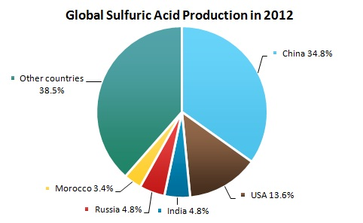
Sulfuric Acid Plants: Location and Cost
Sulfuric Acid Production by Region Typical Component Costs
Over 500 Sulfuric Acid Plants Worldwide
126 in China
73 in the U.S.
60 in India
Component | Cost (2008 €) | Percentage of Cost
Compressor | 56,100 | 1.9
Sulfur burner | 248,010 | 8.5
Heat exchanger | 1,539,330 | 53.0
Contact group | 497,340 | 17.1
Absorber | 561,940 | 19.4
TOTAL | 2,902,720 | 100

Slide 3
Sulfuric Acid Production
Sources of Sulfur
Source | 2011 World Production (1,000 Metric Tons) | Percentage of World Production
Sulfur mining or production from pyrites | 6,970 | 9.5%
Byproduct: Recovered elemental sulfur (Claus Process) --from natural gas production and petroleum refining | 48,600 | 66.5%
Byproduct: Sulfuric acid --from copper, lead and zinc smelting | 17,500 | 24.0%
TOTAL | 73,070 | 100.0%

Slide 4
Trends in Sulfur Supply & Demand
Production of sulfur from oil & gas to increase
Newer oil & gas tends to be sour, contains more sulfur
Dramatic increase in sour gas production from Sichuan field in China expected
More stringent limits on sulfur in gasoline products
Demand for sulfuric acid will remain relatively stable
Forecast is for oversupply of sulfur by 2017
Sulfur mining and pyrite production will decline
Metal smelting activities could feel pressure to reduce operating rates
Other uses for sulfur being explored, such as sulfur enhanced asphalt and sulfur concrete

Slide 5
Petroleum Refining by Region
Worldwide Refining Operations (as of Jan. 1, 2014)
Region | Number of Refineries | Crude Distillation Capacity (b/cd) | Percentage of World CDU Capacity
Africa | 45 | 3,218,085 | 3.7
Asia | 162 | 25,275,612 | 28.7
Eastern Europe | 89 | 10,602,308 | 12.0
Middle East | 43 | 7,393,365 | 8.4
North America | 147 | 21,591,067 | 24.5
South America | 65 | 6,359,987 | 7.2
Western Europe | 94 | 13,588,454 | 15.4
TOTAL | 645 | 88,028,878 | 100.0

Slide 6
Projected CDU Expansions
Trends in Refining Volumes:
Increasing demand in Asia, rise in Asian refining capacity
Continuing growth in Middle East refining capacity
Over-capacity and sliding demand in Western Europe lead to contraction
Regional share of Crude Distillation Expansions:
Region | Share of CDU Expansions 2012-2018
China | 45%
Middle East | 22%
Other Asia | 14%
Latin America | 14%
Other | 5%
TOTAL | 100%

