Slide 1
Purafil
Covid-19 Response

Slide 4
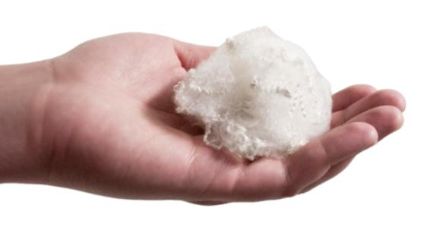
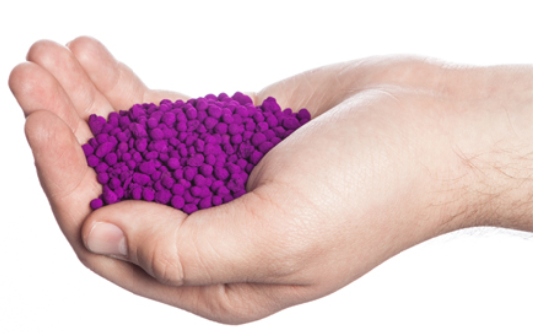
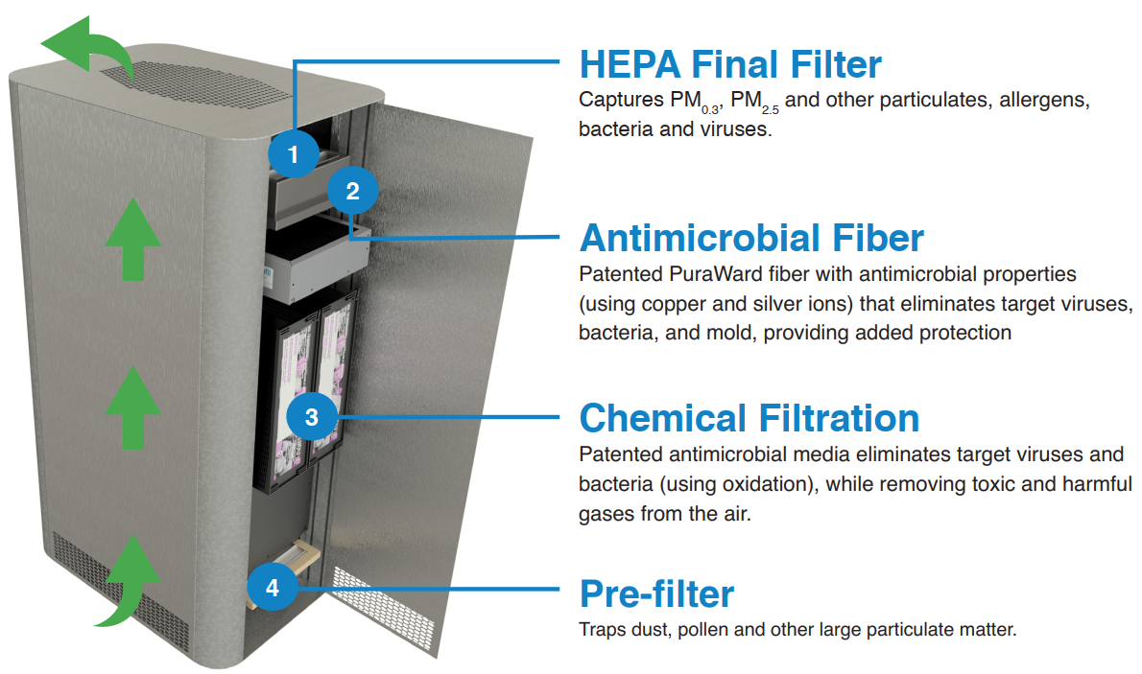
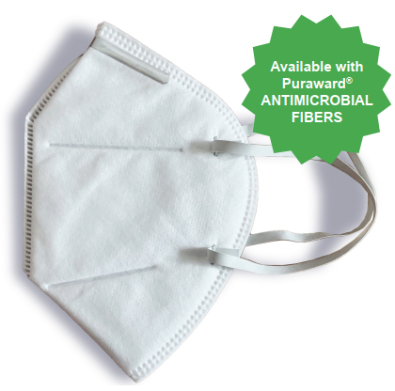
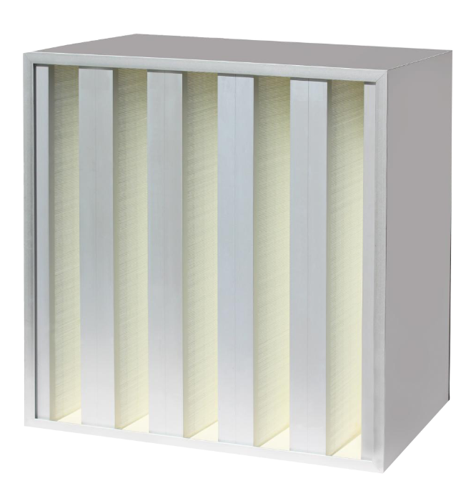
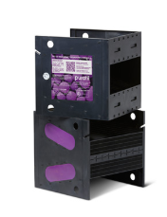
Purafil Products to Fight Covid-19
Puraward Fiber
Chemical Filtration
Air Scrubber

Slide 5
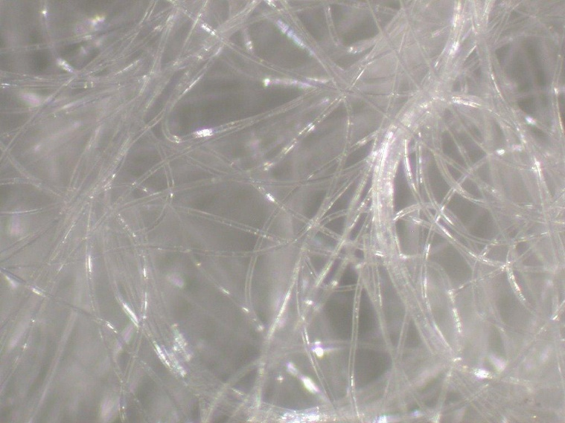
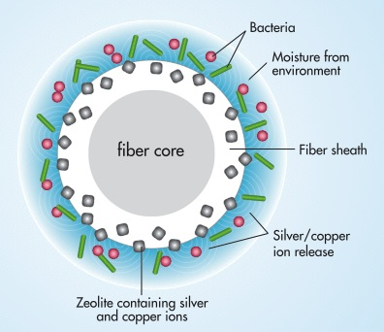
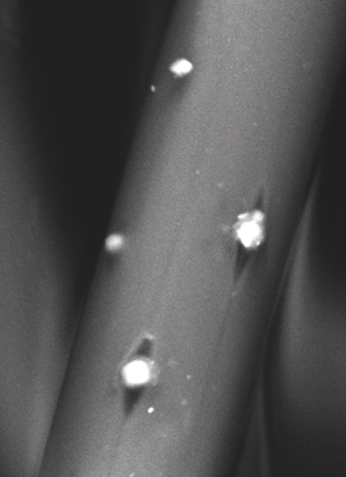
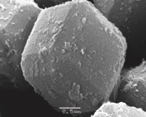
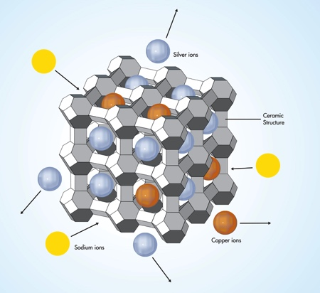
Purafil Antimicrobial PuraWard Fiber
Silver and copper ions in the zeolite carrier exchange with sodium ions found in moisture from the environment, causing a controlled release of silver and copper on demand.

Slide 6
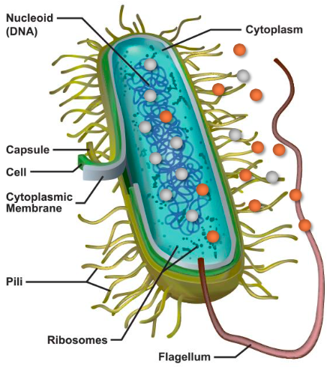
Purafil Antimicrobial PuraWard Fiber – Mechanism of Action
Synergistic Action - Copper readily attacks the proteins/amino acids of the cell wall, allowing silver to invade the cell more readily
Joint Attack Inside the Cell:
Sterilization: Prevents replication
once silver has entered the cytoplasm and reacts with genomic DNA
Suffocation: Causes failure of key enzymes associated with respiratory function
Starvation: Causing the failure of key enzymes associated with transmittance of nutrients across the cell wall

Slide 7
Purafil Antimicrobial PuraWard Fiber- Antimicrobial Performance
Virus | Inhibition Rate | Bacteria | Killing Rate
H1N1 | 99.91%/ 5 minutes contact | S. aureus | 99.95%/ 1 hour contact
H7N9 | 99.98%/5 minutes contact | E. Coli | 99.96%/ 1 hour contact
SARS | 99.58%/5 minutes contact | C. albicans | 98.90%/ 24 hours contact

Slide 8
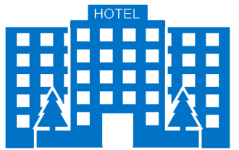
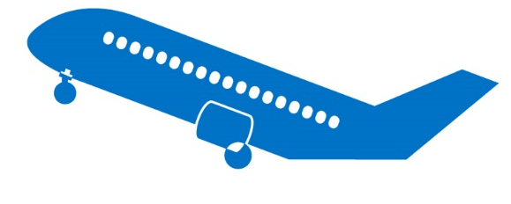
- Markets and Applications
Purafil Antimicrobial PuraWard Fiber
Households
Commercial Buildings
Schools
Aerospace
Automotive
Healthcare facilities

