Slide 1
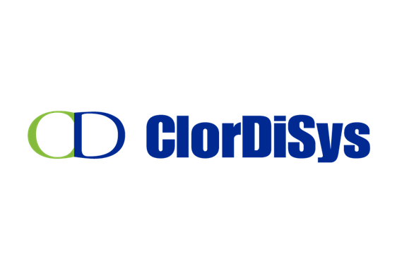
Decontamination and Reuse of N95 Filtering Facepiece Respirators
March 31, 2020
David Shelep
Microbiologist, Consultant
Paramount Sciences
Representing:

Slide 2
Agenda
Background
The need, methods, what is important in sanitizing
Technologies
Ultraviolet light
Chlorine dioxide
Next steps

Slide 3
Background on me…
B.S. Microbiology
Food Laboratory testing
20+ years in Microbiology sales and service
Clinical Microbiology
Pharmaceutical Microbiology
Food Microbiology
Environmental Monitoring
Microbial Identifications
American Society for Microbiology, Northeast Association for Clinical Microbiology and Infectious Diseases, International Association for Food Protection, Parenteral Drug Association
Coordinate my interdisciplinary Microbiology experience for clients and vendors matching their needs and solutions

Slide 4
The need regarding Filtering Facepiece Respirators (FFR) N95’s
It has been anticipated, but measures not widely planned or implemented
Limited reuse has been recommended as an option for conserving FFR
During an influenza pandemic in the U.S. alone 1.7-7.3 billion FFR’s could be needed
The National Institute for Occupational Safety and Health (NIOSH)
PANDEMIC PLANNING - Recommended Guidance for Extended Use and Limited Reuse of N95 Filtering Facepiece Respirators in Healthcare Settings
American Journal of Infection Control, 2018
Ultraviolet germicidal irradiation of inﬂuenza-contaminated N95 ﬁltering facepiece respirators
Devin Mills BS, Delbert A. Harnish MS*, Caryn Lawrence BS, Megan Sandoval-Powers BS, Brian K. Heimbuch MS

Slide 5
Some methods under consideration
Heat
Ultraviolet light
Manual alcohol or bleach cleaning
Hydrogen peroxide
Steam
Microwave
Chlorine dioxide

Slide 6
Considerations for sanitizing or decontaminating
The method must able to kill the organism in question
Bacteria, viruses, fungi, spores, etc.
It must achieve good and complete distribution
Where/how it is applied
It must achieve thorough and total penetration
The chemistry behind the method
Can it achieve sufficient contact time at the correct concentration
Material safety concerns

Slide 7
UV Solution
Ultraviolet Light (UV-C) for Disinfection
Benefits
Quickly kills microorganisms by damaging their DNA
Non-toxic to environment
Leaves no residues
Simple to use
Costs pennies per cycle
Downsides
Shadow areas do not receive dosage
Difficult to effectively use in large areas with many items
Initial cost

Slide 8
UV Solution
Ultraviolet Light (UV-C) for Disinfection
Kills practically all organisms with the proper dosage
Effective within (and limited by) line-of-sight
Kill is dependent on dosage and intensity
Dust and dirt reduces effectiveness
Plain glass and most plastics block UV-C light
Intensity falls with distance
Can burn eyes and skin

Slide 9
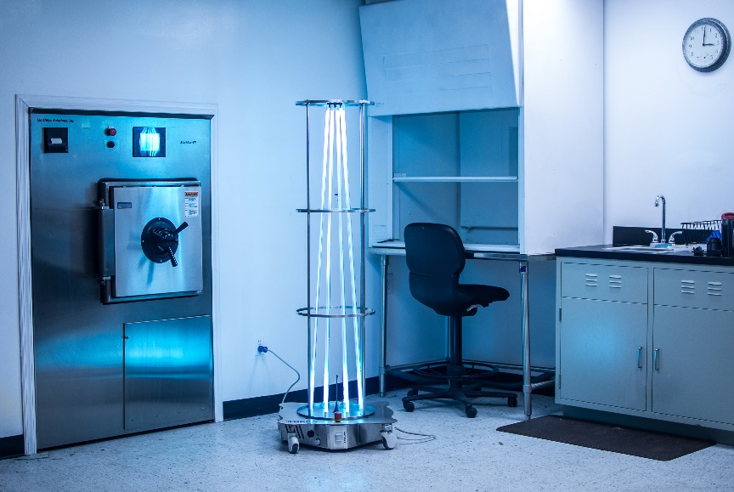
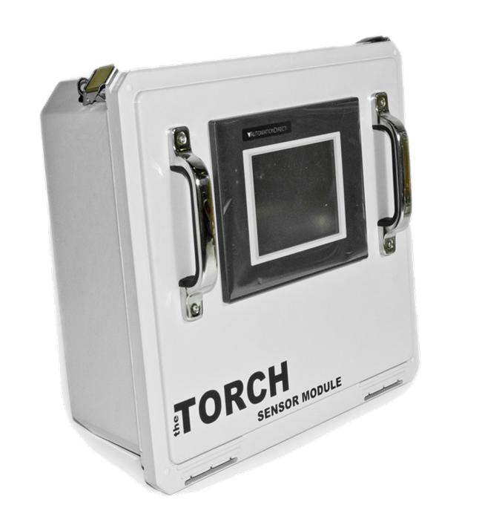
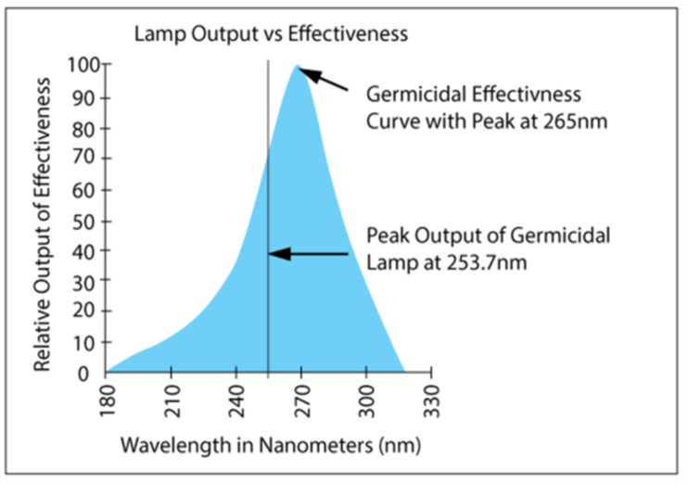
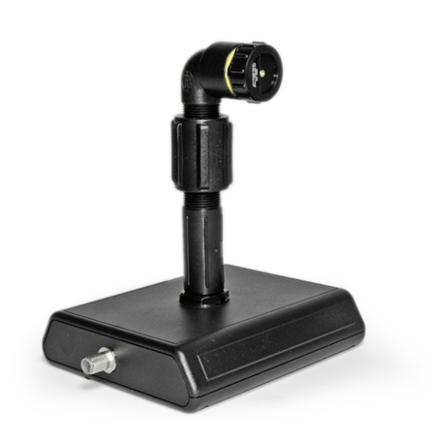
UV Solution
Ultraviolet Light (UV-C) for Disinfection
Primary kill spectrum is 265nm (UV-C)
Peak output of the bulbs is 253.7nm
Nearly all UV systems use the same basic technology

Slide 10
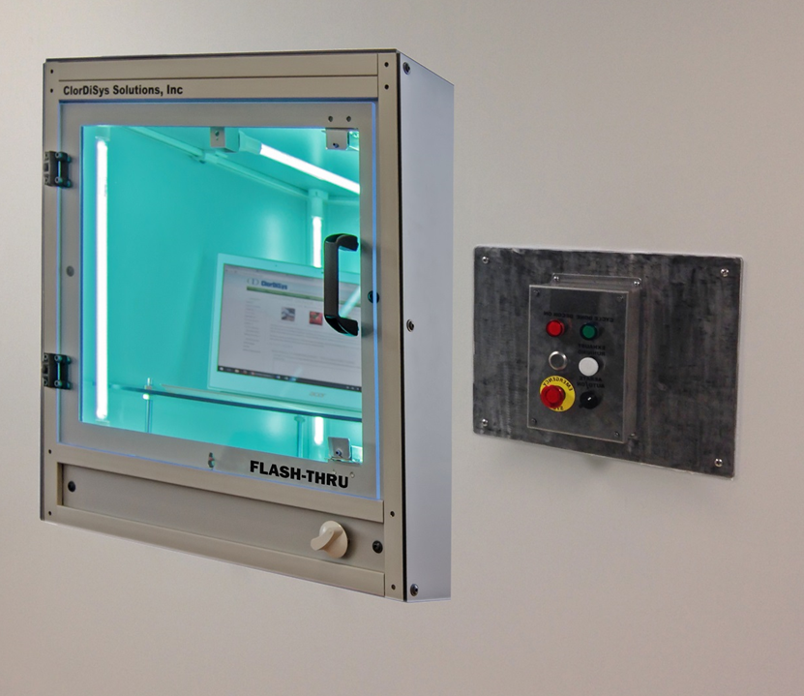
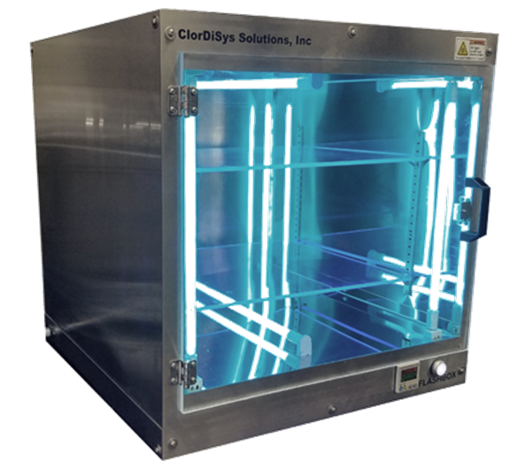
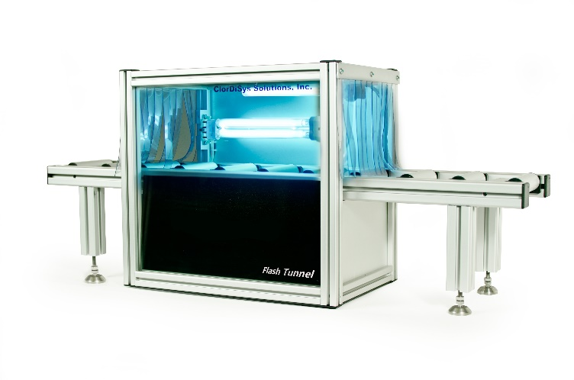
UV Solution
Ultraviolet Light (UV-C) for Disinfection

Slide 11
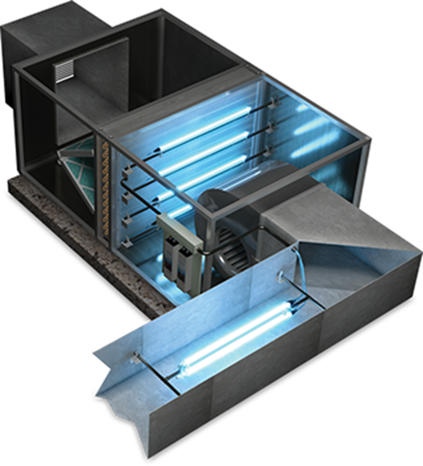
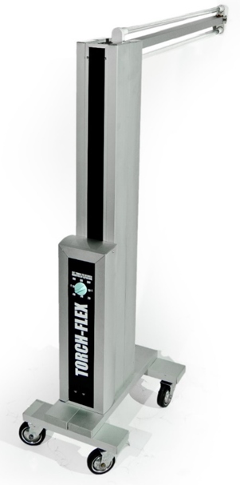
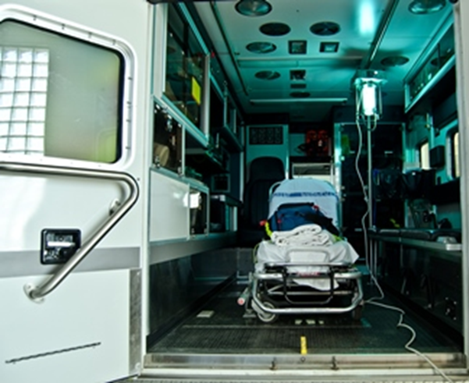
UV Solution
Ultraviolet Light (UV-C) for Disinfection
ClorDiSys will customize

Slide 12
UV Solution
The Nebraska Medicine procedure is practical and easy to implement (if resources are available)
Other UV set-ups could be used
https://www.nebraskamed.com/sites/default/files/documents/covid-19/n-95-decon-process.pdf

Slide 13
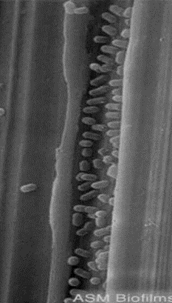
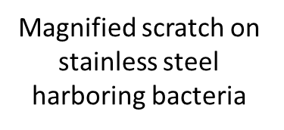
ClO₂ Gas Solution
Chlorine Dioxide (Gas)
Yellow-green gas – ability to monitor with photometric device
Water soluble – not all sterilants can penetrate, vapors cannot
Boiling point 10-11ºC
Not subject to condensation or temperature gradients
Able to penetrate microscopic crevices where traditional sanitation cannot
Gentler on materials than other methods (chlorine, peracetic acid, hydrogen peroxide, bleach)
Non-carcinogenic
Can be used in organic food manufacturing

Slide 14
ClO₂ Gas Solution
Chlorine Dioxide (Gas)
Meets all criteria for an effective sanitization method
Be able to kill the organism in question
Achieve good and complete distribution
Achieve thorough and total penetration
Achieve sufficient contact time at the correct concentration
versus

Slide 15
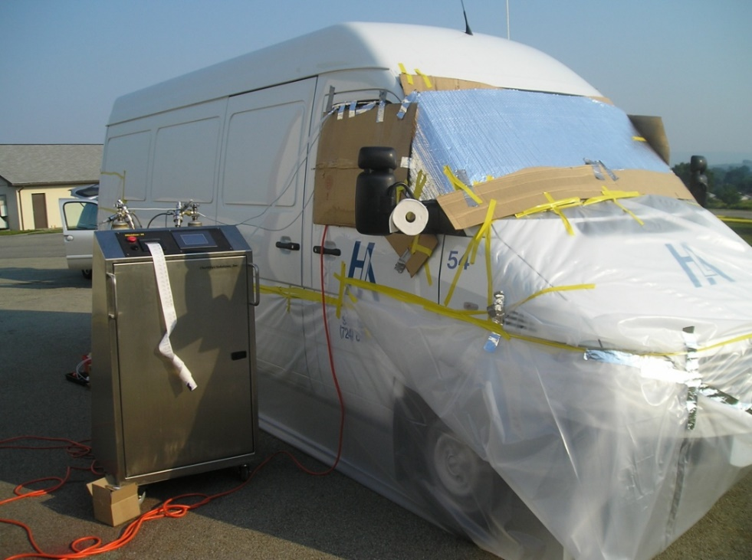
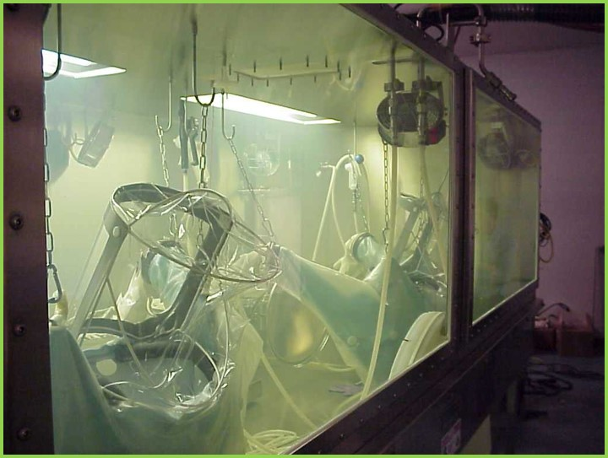
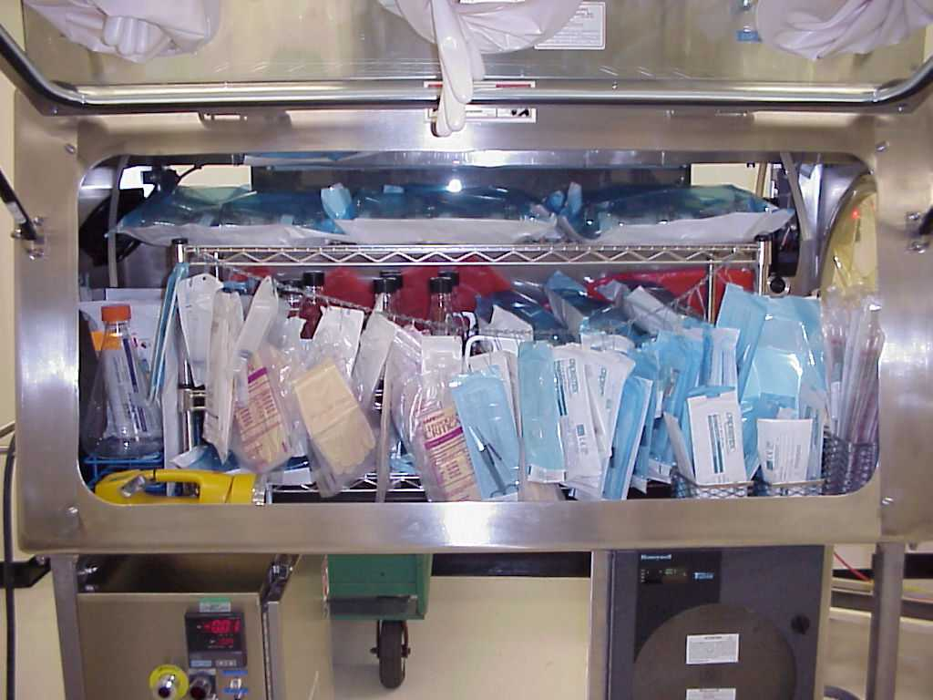
ClO₂ Gas Solution

Slide 16
What action items are needed?
Study references mentioned
Assess where N95 users need help
Find resources of UV and other methods
If a provider can guarantee services, get them on retainer
What can I do for you next?
David Shelep
760-413-5157
david@paramaountsciences.net

