Slide 1

Coronavirus - Masks

Slide 2
Meltblown Supply and Demand
Location | Mask Quantity | Media tons per day at 1 ton/million masks
China individuals in public places | 500 million masks per day with 3 reuses | 166
U.S. If same law in place | 100 million masks per day with 3 reuses | 34
ROW 8 billion people total | 3 billion masks per day with 3 reuses | 1000
Total tons per day |  | 1200
Total tons per year |  | 438,000 tons

Slide 3
Reusable Mask Program - Supply and Demand
Location | # of people (millions) | Uses per day | Number of uses per day (mill) | Number of reuses | Number per day millions | Number per year millions | Cost Each $ | Cost at $/yr millions
N95 non sterilized | 3000 | 0.3 | 900 | 20 | 45 | 16,425 | 3 | 49,275
N-100 sterilized | 200 | 2 | 400 | 10 | 40 | 14600 | 10 | 146,000
Total |  |  |  |  |  |  |  | 195,275
A reusable mask program for everyone would cost $195 billion per year and could be justified on saving just 3366 lives per year at the $58 million per life lost shown in previous webinars.

Slide 4
Reusable Face Masks with Nanofiber Membrane
now Commercial in China
A new type of face mask has been developed in Shanghai using nano technology, which is highly permeable to air but resistant to water.
The new product can endure repeated sterilizations through boiling water, alcohol or disinfectant, and has 20 times the service life of a regular surgical mask.
According to Shanghai-based Wen Hui Bao, the new mask is expected to come into the market within the coming weeks.
Based on an inspection report from the Liaoning Inspection and Test Institute for Medical Equipment, the mask has reached the national criteria for medical protective masks GB19083-2010 in key indicators such as permeability and blood-resisting abilities.
Produced by Juchen Infant and Children's Clothing Co Ltd, the new mask used a high polymer material from Hanpu New Material Science and Technology Co Ltd, both based in Fengxian district, Shanghai.
Juchen was founded in 1994, with a main business of producing children's clothing. The company played an important role in developing and producing face masks for combating the SARS outbreak in 2003. As the novel coronavirus epidemic emerged, the company had planned to reform its production lines to make regular masks. The idea was turned down by the Shanghai Municipal Commission of Economy and Information, which then suggested the company should innovate and create new masks that can be used repeatedly.

Slide 5
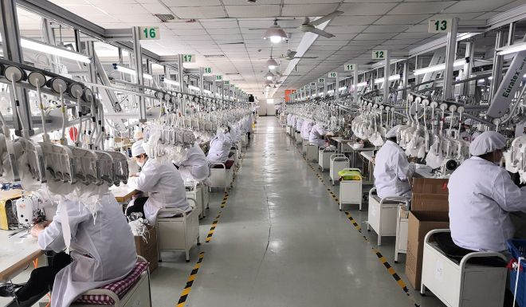
Juchen Reusable Mask Production Using Nanofiber Laminate
Workers produce reusable masks at Shanghai Juchen Infant and Children Garment Company. Photo: Shanghai Economic and Information Technology Committee

Slide 6
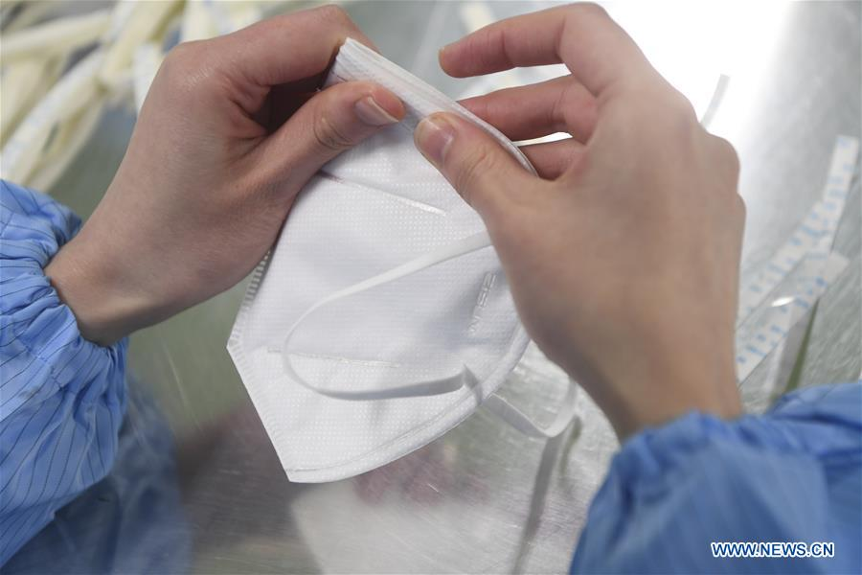

Slide 7
Hanpu has Patent on Nanofiber Film
The commission helped introduce Juchen to Hanpu, a new corporation founded in 2018. Recently Hanpu acquired a national patent for a new material, a thin film of nanofiber, and this was the first time the material was used in face mask production. The micropores in the material can filter 95 percent of tiny objects with a diameter bigger than 75 nanometers, which is the quality standard of N95 face masks. According to the paper, the novel coronavirus has a diameter of about 100 nanometers, while the fine particulate matter in air pollution known as PM 2.5 is 2,500 nanometers or 2.5 microns
Charles Wang, an advanced material professor from a Beijing-based university, said that theoretically, nanofiber can filter the coronavirus because the material can be seen as mini-sized activated carbon.
“It’s also not a problem for nanofiber to be recycled,” he said. “The key in producing a mask is to make sure that the both sides can cover up the face closely, without any cracks in between.”
Wang said the mask’s projected price was “too cheap compared with its cost”.
“I think even if it is sold at 50 yuan, many people will buy it,” he said.

Slide 8
Water, Alcohol or other Disinfectants Compatible with Reusable Media
Two Shanghai companies are jointly producing recyclable face masks, the first of their kind in China, the municipal government has announced.
Shanghai Economic and Information Technology Committee said the new KN95 masks, which adopt nanotechnology, can be reused up to 10 times after disinfection. The factories are now making 100,000 masks per day, and output is expected to reach 300,000 per day on Friday. They will be priced at 15 to 25 yuan (US$2.14 to $3.56).
The committee said it has provided guidance as the mask has been developed, including design, production and sales. Manufacturing is being done by Shanghai Juchen Infant and Children Garment Company and Shanghai Hanpu New Material Hi-tech Company, both located in the Qingpu district.
It is not clear when the reusable masks will be available for sale. The Xinmin Evening News reported that besides the portion allocated by the government, the remainder will be sold on Pinduoduo, a mainland e-commerce site.
Inside the mask is a thin nanofiber membrane that can filter 95 per cent of particles as small as 0.075 micrometers in diameter. The coronavirus is about 0.1 micrometers in diameter.
The manufacturers found that the mask could maintain its filtering ability for 20 uses after being cleaned with boiling water, alcohol or 84 disinfectant liquid, although they recommend that wearers use it no more than 10 times.
The mask’s filtering ability can last for 200 hours, more than 20 times that of normal disposable mask

Slide 9
Reusable Masks in Chinese Strategic Reserve
Conventional disposable medical masks or N95 masks are made of melt-blown non-woven fabric as their main material, and the two layers of non-woven fabric are welded together by an ultrasonic process. The manufacturers of the new KN95 masks claim that a different method of production means that their masks can be used up to 20 times after being cleaned with boiled water, alcohol or diluted bleach, although the manufacturers advise that wearers stick to 10 usages for maximum effectiveness.
The reusable range also boasts a longer shelf life than disposable versions. That means that, even after the epidemic, the new masks could serve as a “strategic reserve for the country,” Liu Boying, Commissioner of Epidemic Prevention in Shanghai’s Fengxian district, told Shanghai Observer.
Charles Wang, an advanced materials professor from a Beijing-based university, told the South China Morning Post that nanofibre can filter out coronavirus germs because the material serves as mini-sized activated carbon. “It’s also not a problem for nanofibre to be recycled,” Wang adds. “The key in producing a mask is to make sure that both sides can cover up the face closely, without any cracks in between.”
To keep the reusable masks affordable, the first batch have been priced at Rmb15 ($2) each, implying a cost to wear of about Rmb1 a day, says Sina Finance.

Slide 10
Expanding Production
The more immediate problem is how to make them in large numbers. Workers at Juchen, the baby clothes supplier chosen to manufacture the new product, must sew the masks.
Its factories have also complained about a limited supply of nanometre materials. Authorities in Shanghai said they are working on coordinating the supply of raw materials and that they have offered financial aid to Juchen to add manpower and machinery. At the moment, the manufacturer can make about 100,000 masks a day, with the expectation of scaling up to 300,000 in the near future.
Orders are mainly being taken from enterprises in Shanghai, which plan to give them to their employees. Another Chinese company Supield has released what it claims to be a similar product on various e-commerce platforms. Its reusable mask, which offers a water resistant layer, also uses nanofibre as a filtering agent, says ThePaper.cn.

Slide 11
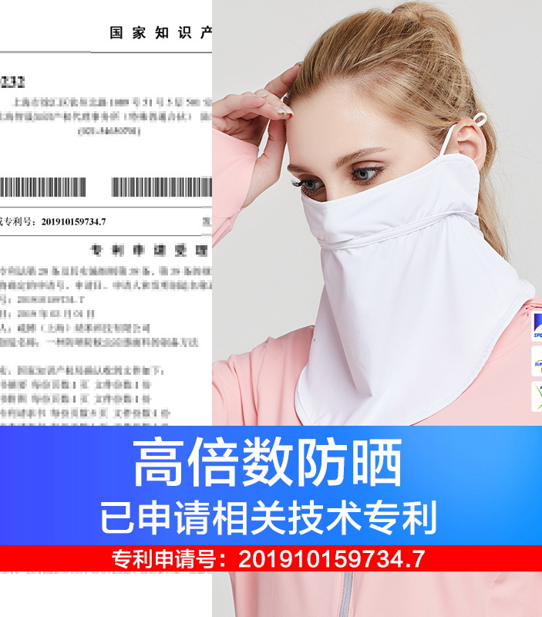
Supield is now making reusable masks using nanofiber laminates. The company is a beauty mask manufacturer

Slide 12
Reusable Masks to meet the 100 million per day Need in China
Last month, companies in Guangdong province, Beijing and Shanghai reported producing a new type of face mask that uses a nanomaterial membrane, rather than the typical melt-blown fabric, to filter bacteria, viruses and other pathogens, according to local health and medical products authorities.
The new masks are on par with N95 standards, meaning they filter particles of all sizes with at least 95 percent efficiency. The masks are also comfortable, easy to breathe through and can be reused up to 20 times depending on the user's setting and wear time, the authorities said.
The retail price for the masks created by companies from Shanghai will be around 15 to 20 yuan ($2.14 to $2.85) each. The prices for the ones made by Beijing and Guangdong companies are still unknown because those companies just recently began production.
On Feb 21, Premier Li Keqiang said during an inspection of one of the mask makers in Beijing that China would need to boost efforts to push face mask production to over 100 million a day to meet national demand.
Li said face mask supply is a basic prerequisite for resuming work and production and serves as a key medical and psychological barrier that protects the public.
Li urged the National Medical Products Administration to speed up appraisal of nanofiber membrane masks so factories could scale up production once approval is granted.
https://www.chinadaily.com.cn/a/202003/02/WS5e5c5f83a31012821727b74f.html

Slide 13
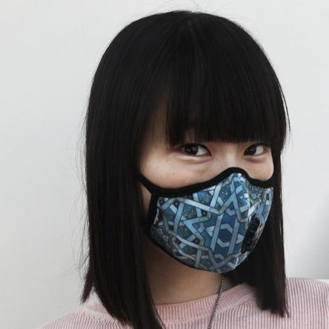
Vogmask is the Original Stylish Filtering Half Mask for Particles
First imagined in 2011, Vogmask created a unique facemask to bring design and reusability to highly efficient filtering. Our mission has never changed: to give the world a mask that makes you look great while providing the protection from airborne particles. Vogmask is used for protection from airborne particles such as PM 0.3, PM 2.5, PM 10, dust, allergens, post combustion particles, germs, shavings, biologics, odors, scents, mold, mold spores, particles in wildfire smoke, volcanic particulate pollution, and other airborne contaminants.
The benefits of particulate respirators are confirmed by leading health providers worldwide. Highly efficient filtering masks help protect the mask wearer from particles .254 microns and smaller. Working together with quality management engineers, we offer an important tool for consumer health. Vogmask is a no-risk, high-reward method to protect respiratory health and to contribute to a worldwide dialogue on the very important topic of cleaning the air.
Vogmask on the runway:
Hong Kong Fashion Week
June 27, 2014

Slide 14
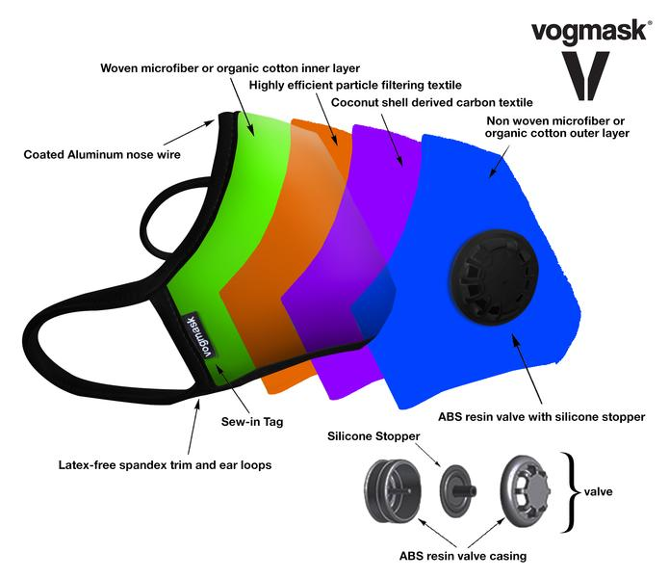

Slide 15
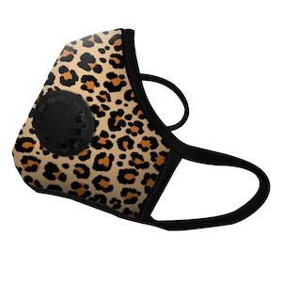
N95 Particle Penetration Filtering Efficiency, Filter class provides >99.9% Viral and Bacterial Filtering Efficiency, Safe and Comfortable Breathing Resistance, Valves Tested for no inward valve leakage.
The NIOSH N95 filter efficiency as stated in 42 CFR Part 84.181 is a minimum efficiency for each filter of ≥ 95% ( ≤ 1% penetration) . The test articles submitted by the sponsor conform to the NIOSH N95 criteria for filter efficiency.
POOR AIR QUALITY
Vogmask is widely used in urban environments due to the high levels of air pollution. Particulate matter (PM) is classified based on the size of particle diameter. Vogmask protects from inhaled particles as small as 0.3 micron

Slide 16
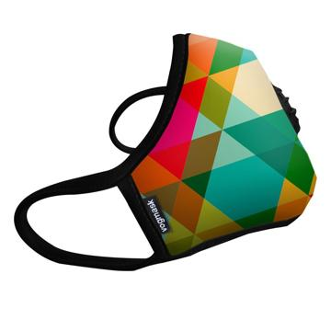
The filter media in Vogmask is sewn into the middle layers of the mask and is not replaceable. The disk on the side of the mask is a one way exhalation valve to facilitate the exit of moisture and CO2 from interior of the mask. The masks can be maintained by hand wash and hang dry. Raw materials are: Organic cotton or microfiber outer and inner layer, microfiber particle filter, coconut shell derived carbon ash bonded to textile, latex free spandex trim and ear loops, aluminum noseband, ABS Resin exhale valve base and cover with silicone stopper. MATERIAL DATA SAFETY SHEETS have established material components as safe for respirators. There is NO LATEX in the manufacture of Vogmask, and Vogmask is printed with safe for respirator inks and dyes.

Slide 17
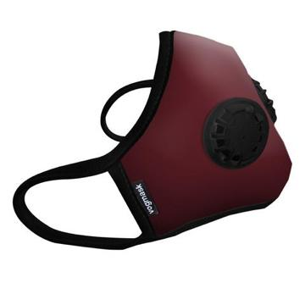
VM Organic and VMC2V Organic Vogmasks are solid color dyed outer layer organic cotton, N95 particle filtering media, carbon filter, and (VMC2V) two exhalation valves for facilitating exit of moisture and CO2 from the interior of the mask.

Slide 18
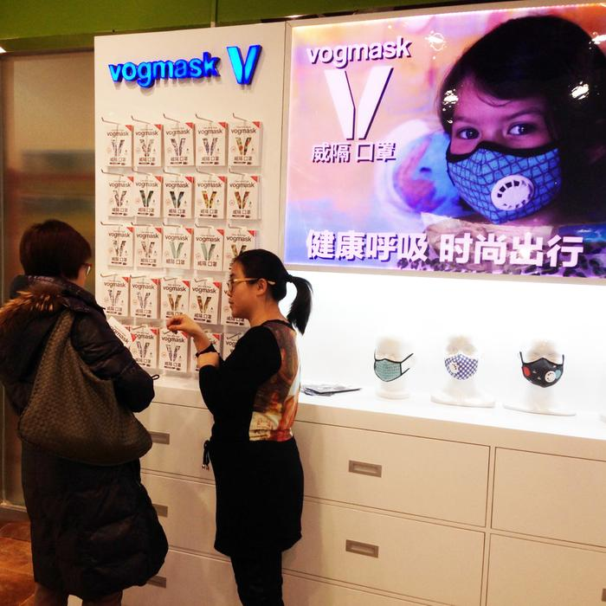
FIRST VOGMASK RETAIL STORES IN CHINA
November 20, 2013
WELLNESS
In certain circumstances, each of us has thought, "I shouldn't be breathing this." The quality of air we breathe contributes directly to our health.
Vogmask offers protection from microscopic particles resulting from air pollution, dust, smoke, allergens, biologics, and natural causes. Wellness results from conscientiously applied healthy living principles and starts with breathing clean air.
Vogmask is efficient for protecting from viral and bacterial airborne particles, fitted properly.

Slide 23


Get both comfort & top-to-bottom protection with new HALYARD* FLUIDSHIELD* ASTM rated specialty surgical masks. HALYARD*, the leader in facial protection, offers a full line of ASTM F2100-11 rated fluid protective masks — with unique comfort features designed to satisfy your OR staff

