Slide 1
Coronavirus Mask Decontamination

Slide 2
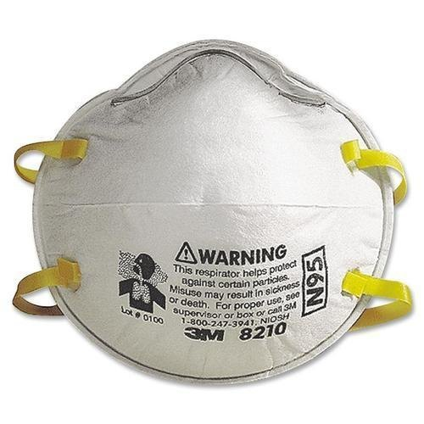
N95 Mask Materials
Non-woven polypropylene (other materials possible)
Various elastic strap materials
Varying materials on both sides of PP (optional)
Metal nose piece (for fitting to nose) (optional)

Slide 3
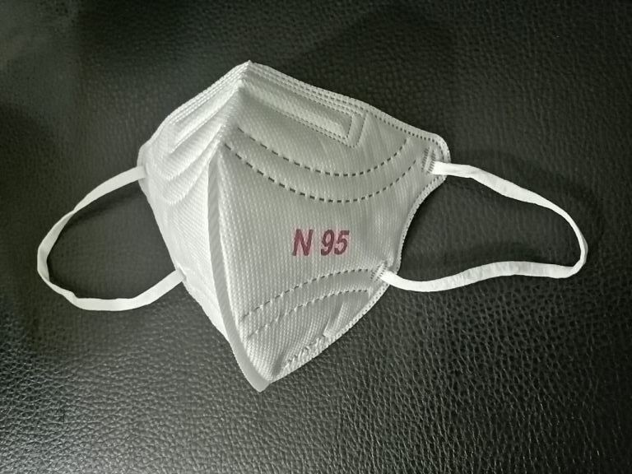
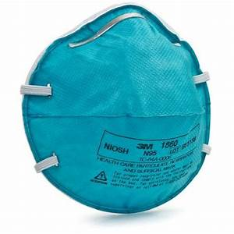
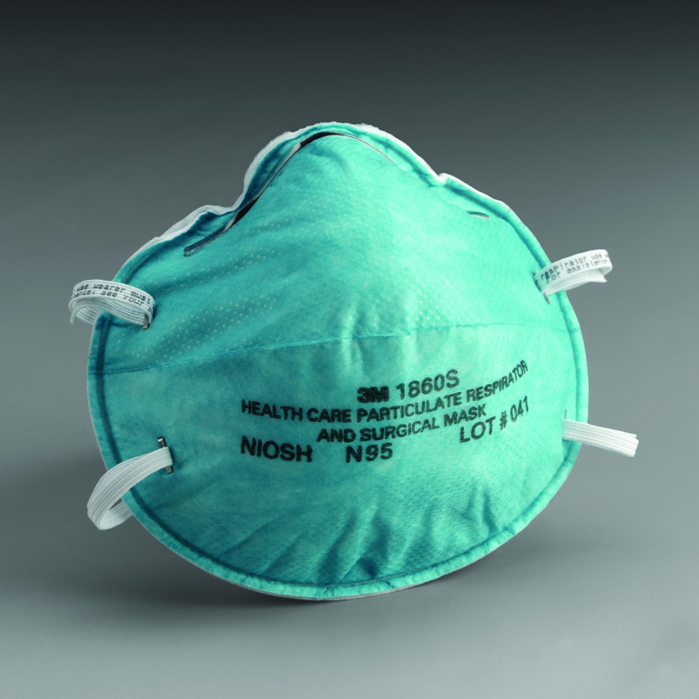
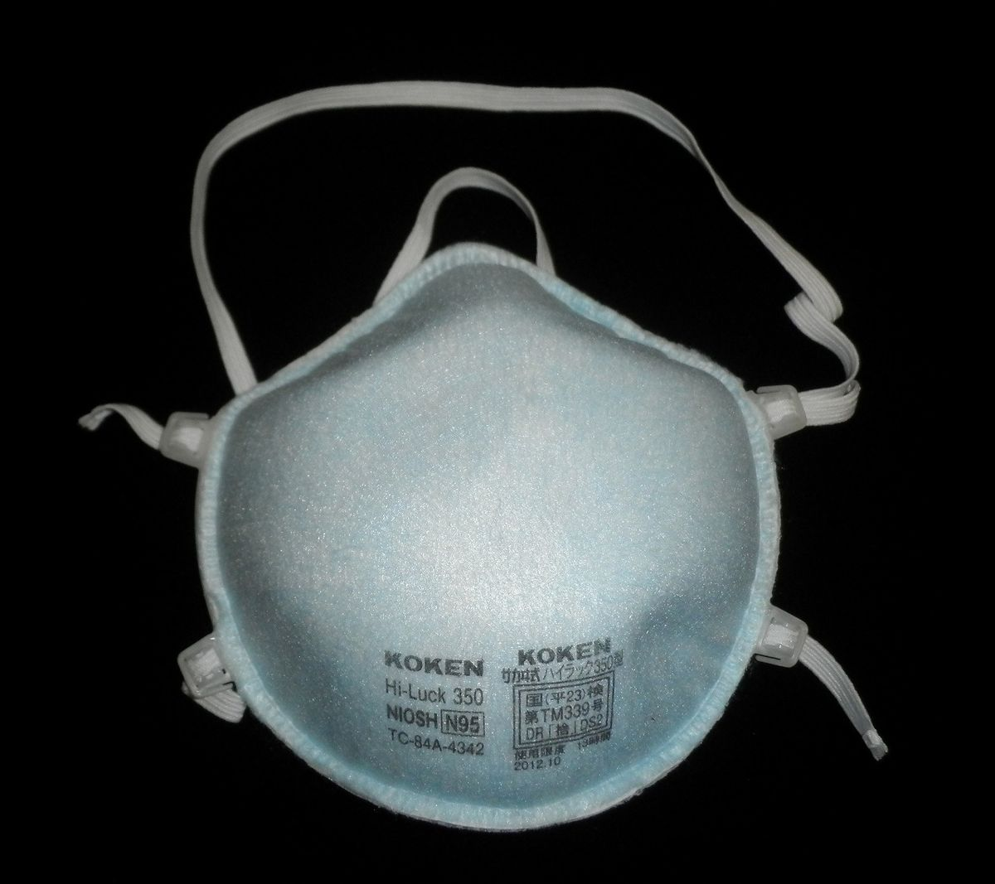
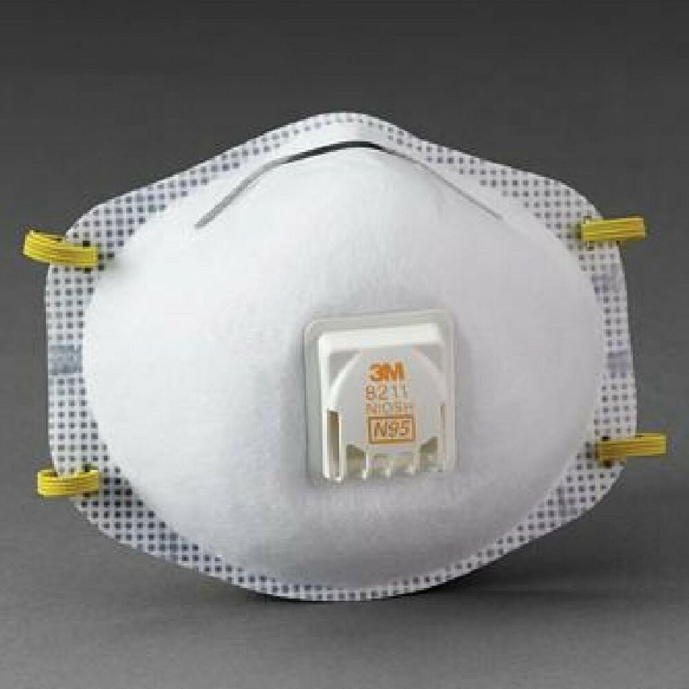
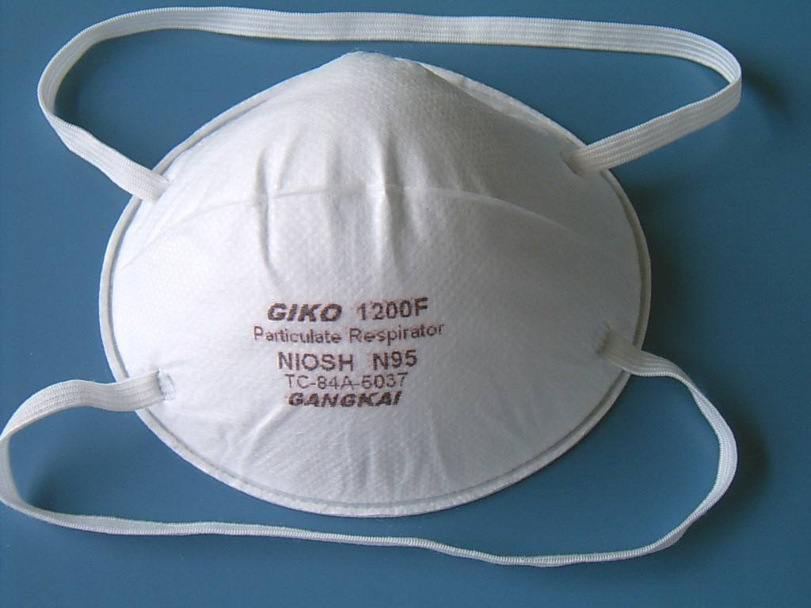

Slide 4
Sterilization / Decontamination Methods
Steam – 121C for 15 minutes, 131 for 3 minutes
Dry Heat – 170C for 30 minutes
Radiation - >25 kGy
Gas – ETO, ClO₂, NO₂, O₃
Vapor – H₂O₂ vapor or aerosol delivery, H₂O₂ Plasma (AST)

Slide 5
Materials & Processes
 | Steam | Dry Heat | Radiation | Gas | Vapor
Polypropylene | OK | ? | No | OK | OK
Straps | ? | ? | ? | ? | ?
Added layers | ? | ? | ? | ? | ?
Nose piece | OK | OK | OK | OK | OK
X
X

Slide 6
Process Issues
 | Steam | Gas | Vapor
In Hospital | Yes | Maybe | Yes
Process Time | Minutes | 4-6 Hours | 2-3 Hours
Time to Implement | Days | Days | Days
Capacity | Small? | Limited | Large
X

Slide 7
Steam or H₂O₂
Steam – uses hospital sterilizers, available capacity unknown, potential effects on non-critical components unknown.
Vapor – retrofit room with H2O2 generator external, capacity could be extensive, potential effects on non-critical components unknown.
Expecting a variable mix of N95 masks in any load, the effects of steam or H₂O₂ can’t be accurately predicted. Lot’s of conflicting reports. Impact on strap elastics is likely the major factory in reuse.

