Slide 1
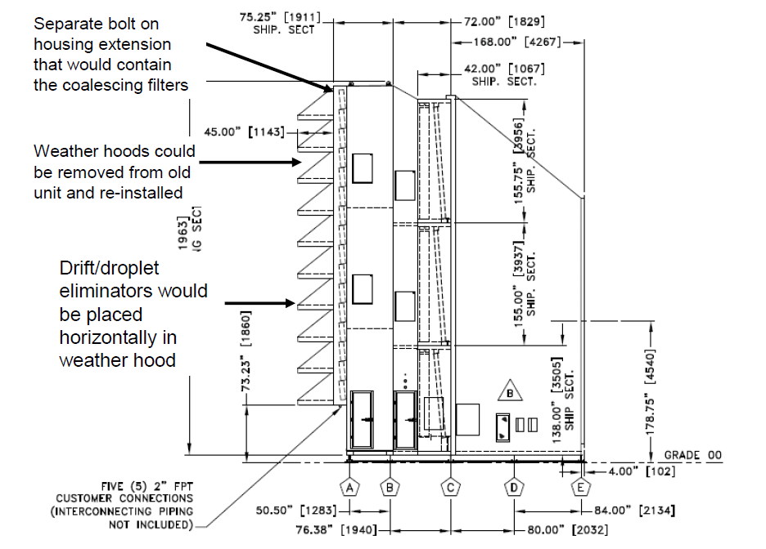
Addressing Moisture Issues

Slide 2
Addressing Moisture Issues

Slide 3
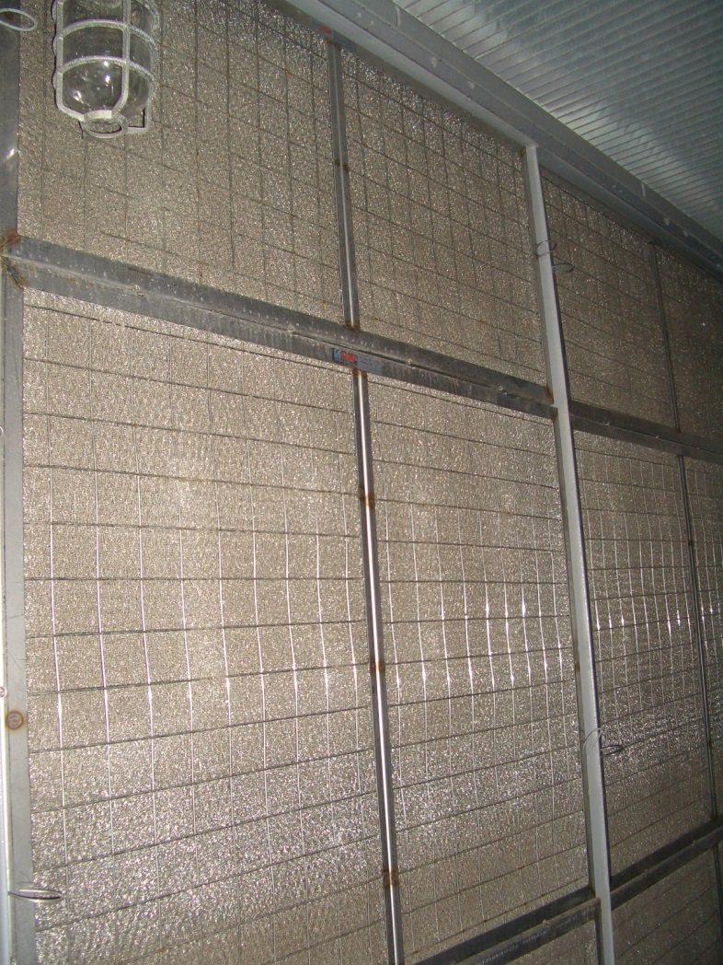
Mist/Droplet Eliminator

